Slide 1
GlassML: Panel-Scale Glass Interposer with Integrated
Reconfigurable Optics for Extreme-Scale ML
PRISM TTA
Yue Pan, Junda Chen, Mingjia Huo, Zihan Xia, Jaewon Lee
PIs: Tajana Rosing, Mingu Kang, Keren Bergman, Madhavan Swaminathan, Ning Li

Slide 2


ML Workloads Needs Infrastructure to Scale
Agentic Workloads
Personal assistant (OpenClaw), coding agent(Claude Code), computer-use agents (CUA)
Inference: Long-horizon, long context, high concurrency demand, low per-user token latency
Training: larger models (e.g. est GPT 5T parameters), Reinforcement Learning (RL)
World Model
Video / physics / embodied world models
Inference: real-time simulation to “think” and act smartly
Training: massive activation + KV traffic across thousands of GPUs
Demand to Infrastructure
High memory bandwidth and capacity (KV caches, model weight)
High network bandwidth (KV transfer, disaggregated prefill/decode, expert routing)
Not necessarily always more compute
⇒ Absolute challenge for today’s infrastructure!

Slide 3
ML Workloads Are Outgrowing Infrastructure
Capacity wall
Trillion-param LLMs far exceed single-node VRAM (DeepSeek-V3: ~0.7 TB, Kimi-K2: ~2 TB)
Workarounds such as activation checkpointing recovers memory at the cost of 33% runtime overhead
Workarounds tax throughput: activation checkpointing has ~33% throughput penalty
CPU offloading interrupts the training pipeline and incurs PCIe-bound stalls
Bandwidth wall
Limited size of high-bandwidth domain
Communications such as all-to-all in MoE training takes 33–55% of iteration time [MixNet, SIGCOMM'25]
Static topology cannot match drifting, non-uniform traffic
Scaling wall
Silicon substrate area has stagnated at 12-inch wafer for decades
Wafer-scale processors require monolithic fabrication, preventing post-fab integration of heterogeneous known-good dies

Slide 4
Panelscale Glass Interposer
“An NVL rack on a panel”
Panel-Level Packaging (PLP) uses 50cm x 50cm glass panel as a packaging solution
Enabling much larger scale of integration in a single substrate
Heterogeneous compute and memory integration: xPUs, HBM, 3D-DRAM
Optical integration
At the distance of 50cm by 50cm, copper-based interconnect cannot sustain without loss and repeater overhead
Optical communication using embedded waveguides enables repeater-free communication across panel

Slide 5
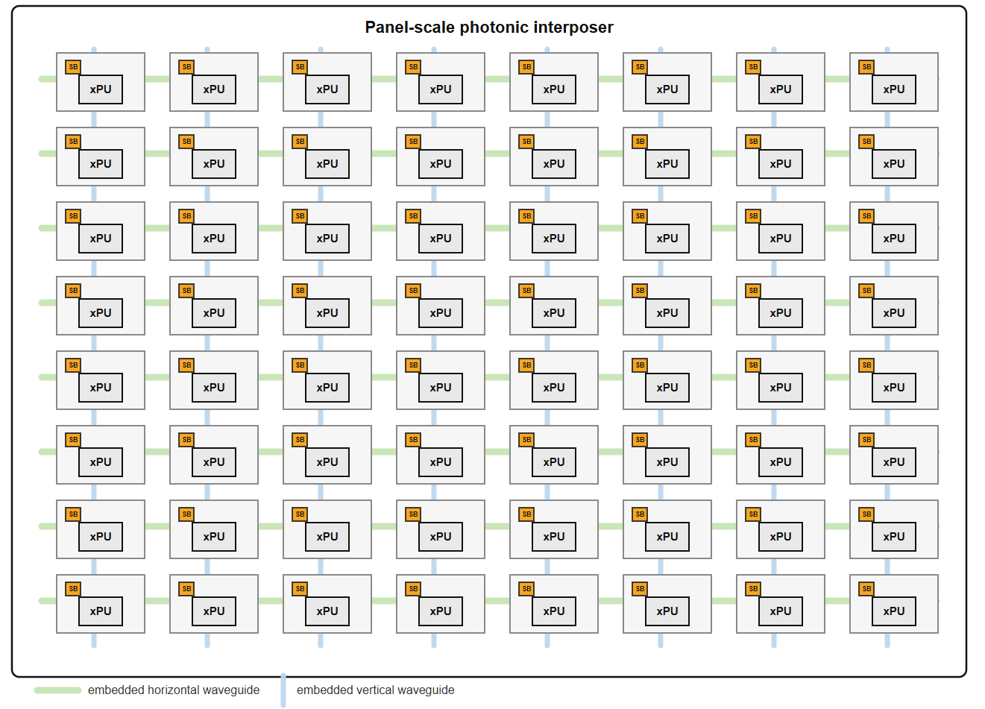
GlassML Architecture Vision
64 GPUs laid out on a 50cm x 50cm panel in 8x8 mesh

Slide 6
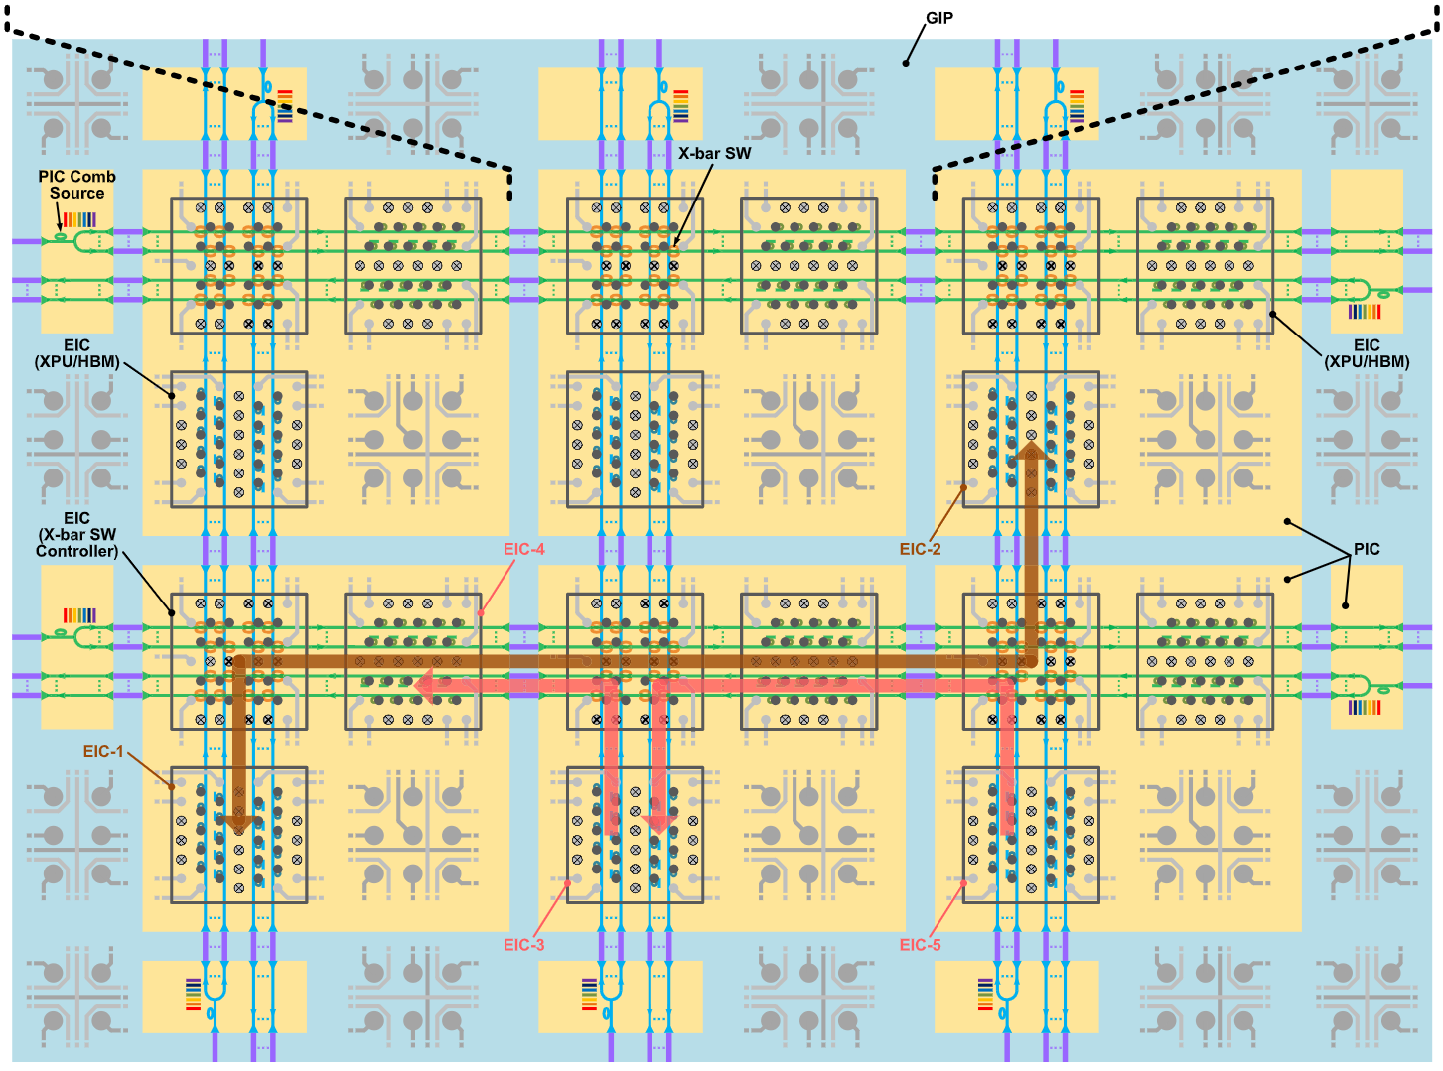
Glass Interposer Overview
Input Laser
Input Laser
Optical Switching Crossbar
Tile
Tile
Horizontal WGs
Top-down View
Vertical WGs
50cm x 50cm

Slide 7
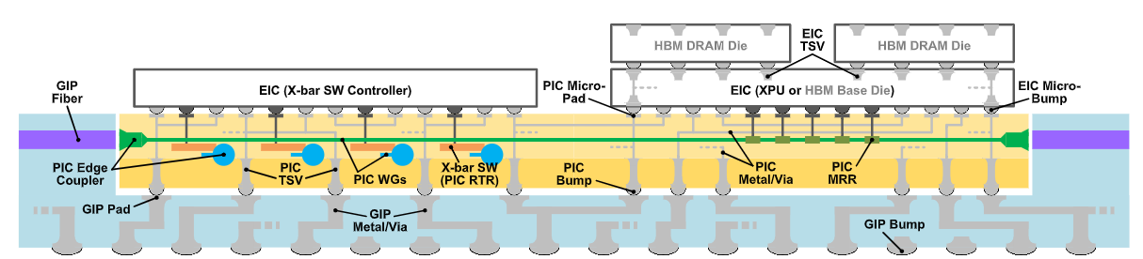
Glass Interposer Components
Tile
  Carved slots on the glass panel to contain PIC, EIC, and switching fabric
EIC (Electronic Integrated Chip)
  Examples: xPUs, memories, accelerators, CPUs
  Known-Good Dies (KGD) integration – allowing standalone xPU testing
PIC (Photonic Integrated Chip)
  EIC’s photonic interface – handles electric to optical (E/O) conversions
  Each E/O converters connects on exactly one signal pin on the xPU
Waveguides (WG)
  Carries light signal, akin to a light fiber and are embedded into or deposited on top of glass
  WDM (Wavelength-Division Multiplexing) can be used to improve per-WG bandwidth
Side
View

Slide 8
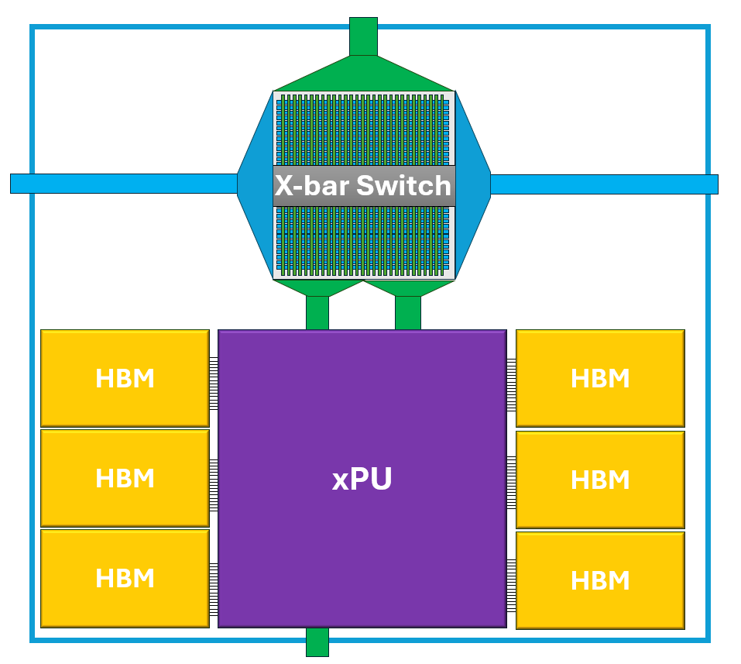
Glass Interposer Tile
Example: H100 GPU as EIC
EIC and xbar switching are connected via microbumps to allow data communication between EICs in different unit interposers
Traditional EIC layout can be preserved and allows integration of Known-Good Dies (KGD)
Notes:
Previously this is known as “unit interposer”. But I replaced this term with “tile” so that it is easier to be understood and said.

Slide 9
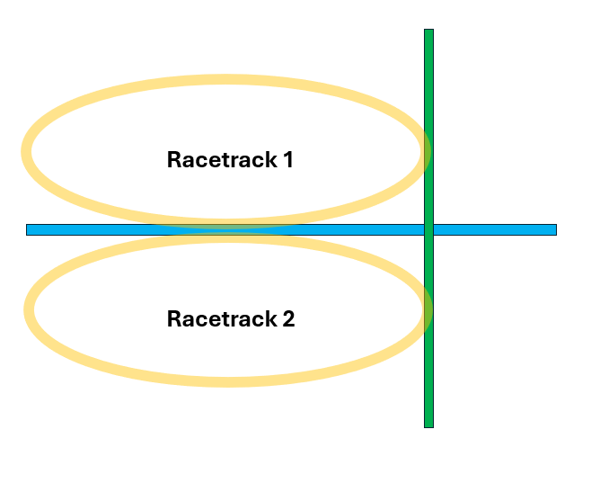
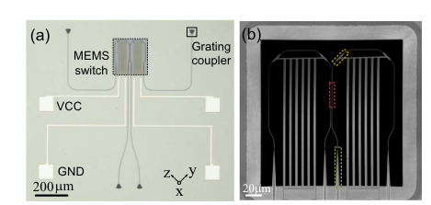
Switching fabric
At each tile, horizontal WGs and verticals WGs form intersections inside the glass.
Option 1: Vertically-Coupled Add-Drop Racetrack Resonator (VC-AD-RTR)
2 Racetracks are placed at each crossing of vertical and horizontal links
Broadband switching for all WDM channels
between any direction of the optical crossbar
Reconfiguration time: <10us [Optical Express’10]
Option 2: Piezoelectric MEMS
Tiny mechanical switch at each crossing that bends a waveguide into place to route light
Works for all WDM channels at once, no per-wavelength tuning needed
Sub-microsecond switching [Photonic Research’26]
Racetrack-based Switching
[Optical Express’10] https://opg.optica.org/oe/viewmedia.cfm?uri=oe-18-10-9852&html=true
[Photonic Research’26] https://opg.optica.org/prj/fulltext.cfm?uri=prj-14-4-1625
Piezo-MEMS-based Switching
Notes:
VC-AD-RTR is shortened as “racetrack”
Piezoelectric MEMS is shortened as “piezo-mems”
The reason the racetrack is so big is because the light has to travel a certain distance inside the racetrack. HOwever I was told that it doesn’t have to be racetrack shape which may reduce its footprint.

Slide 10
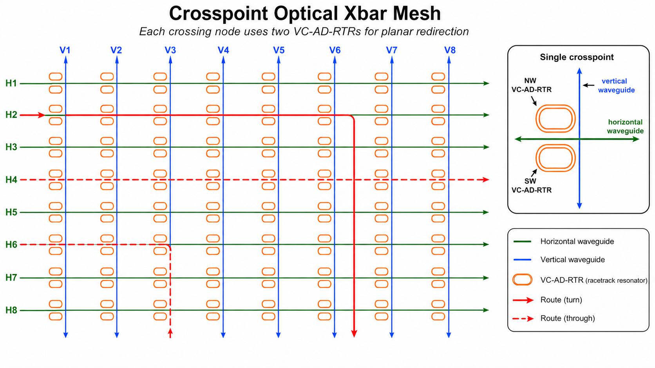
Glass Panel Routing Infrastructure
Example 8x8 xbar shown.

Slide 11
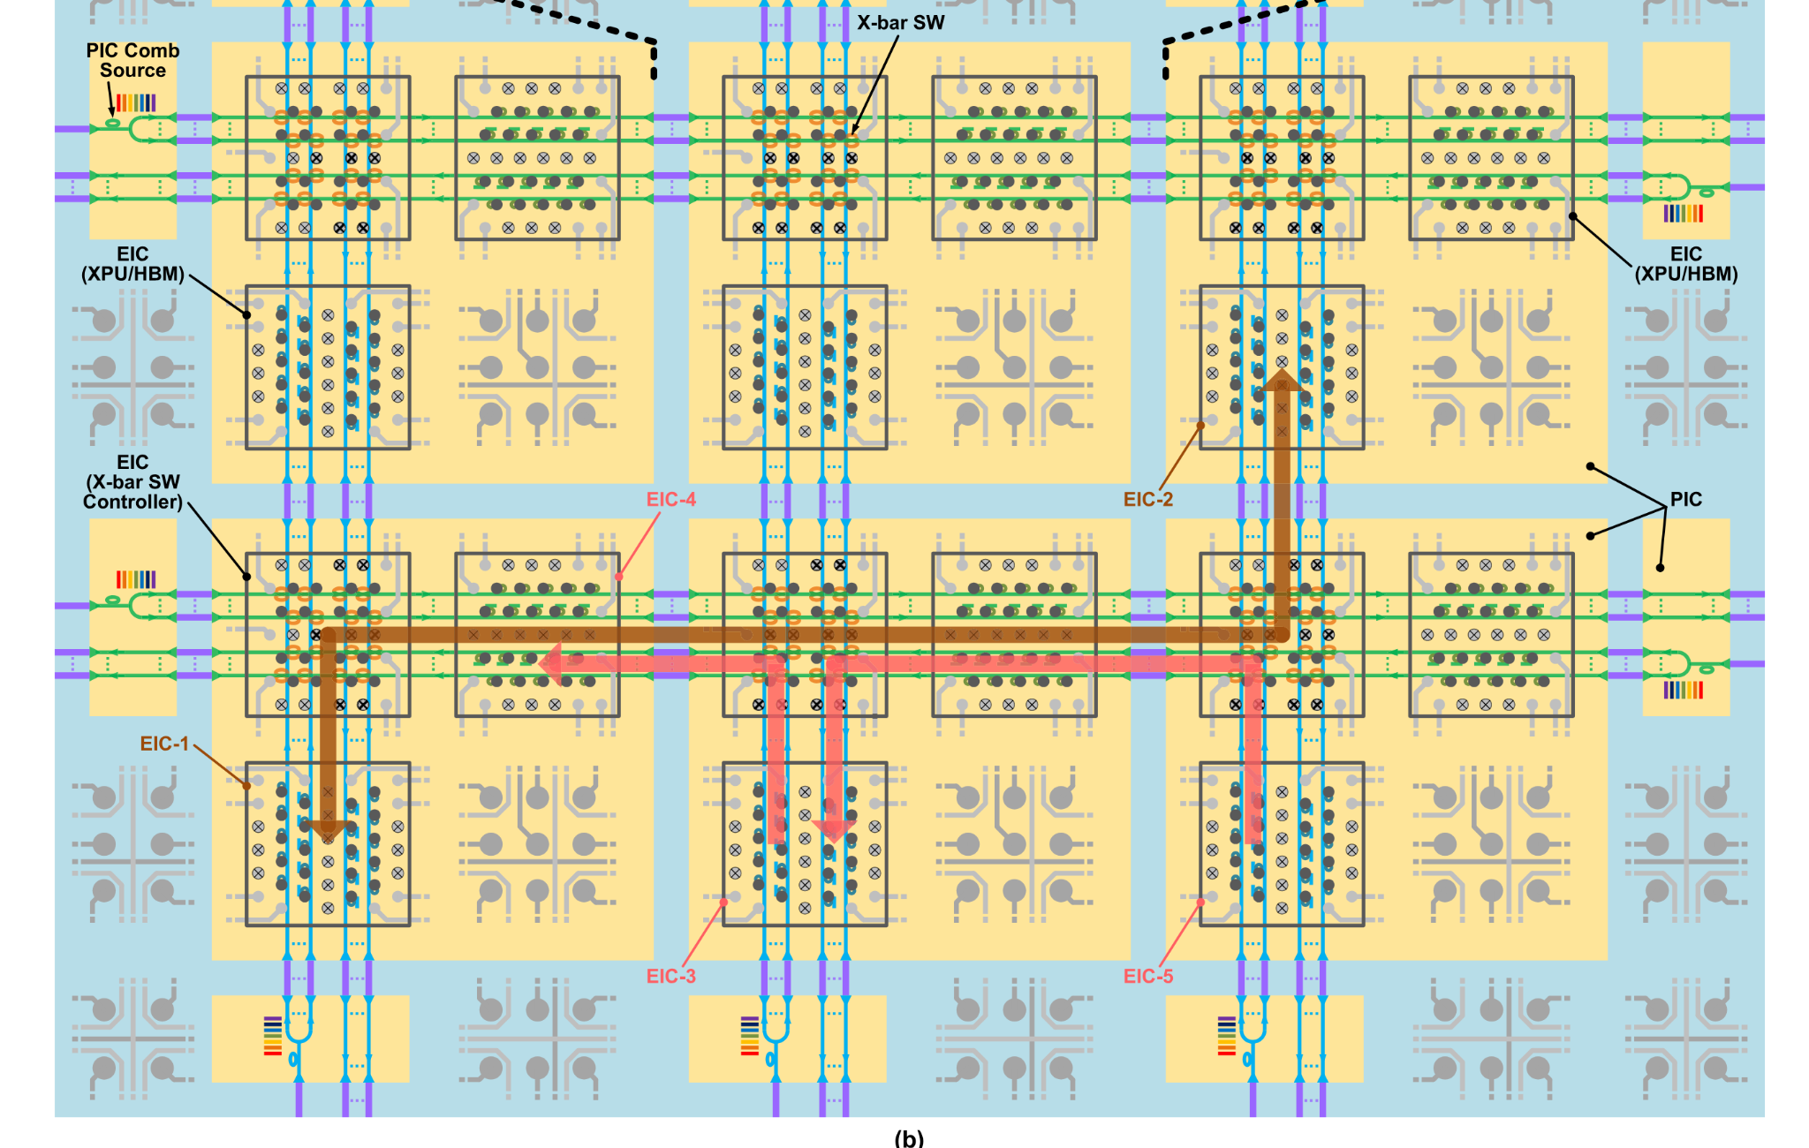
GlassML Routing
Reconfiguration optical interconnect require optical circuit switching, different from packet switching commonly used in copper-based interconnect.
Resource contention
WG, Rx Tx E/O converters
Brown and red communication paths must not take place simultaneously using the same WG
The two red communication paths can take place simultaneously on the same WG
Bandwidth reconfigurability
Each node-pair can be allocated different bandwidth depending on needs

Slide 12
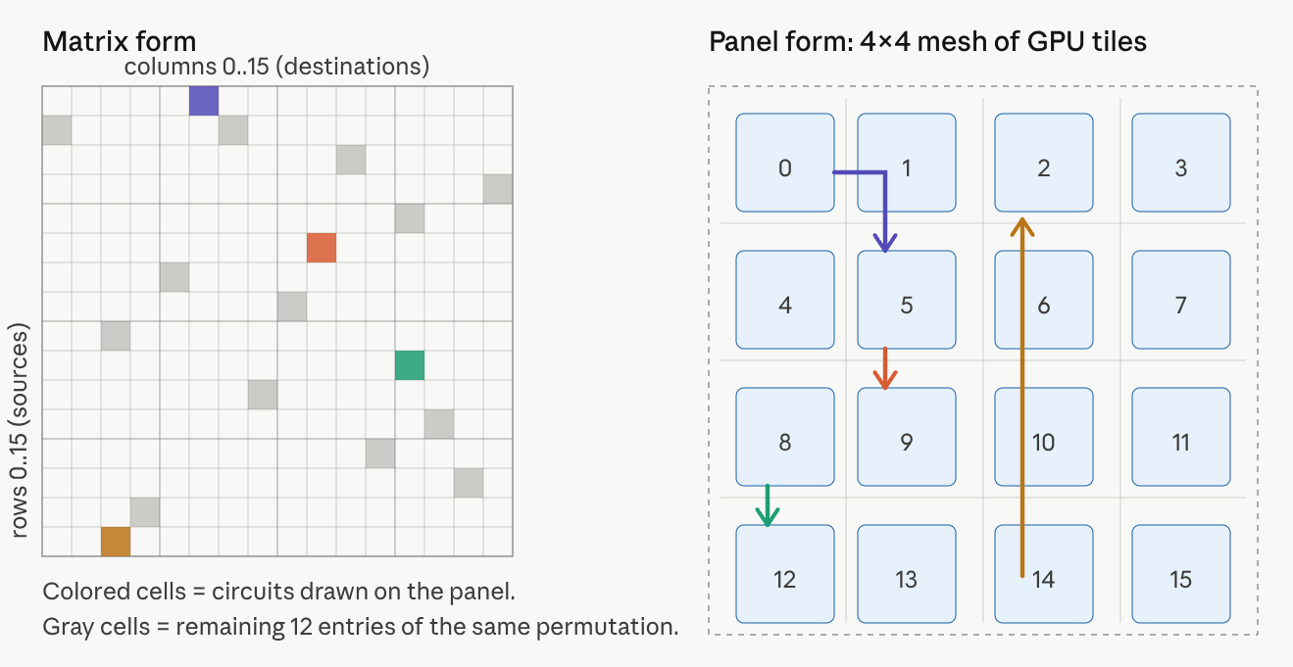
Routing algorithm
Given
  Any collective communication can be expressed with a demand matrix D
  Reconfiguration latency δ
Find
  A set of permutations {P_1 … P_k} and durations {d_1 … d_k} such that ∑ₖ dₖ · Pₖ ≥ D, thus completing the communication demand
  Pₖ is an N×N permutation matrix of 1 and 0s that denotes the connections between GPU pairs
  Goal is to minimize the makespan, M = ∑ₖ dₖ + δ · K
  makespan is the wall-clock time from the start of the communication until all demand has been delivered
Example of a permutation and corresponding circuit setup

Slide 13
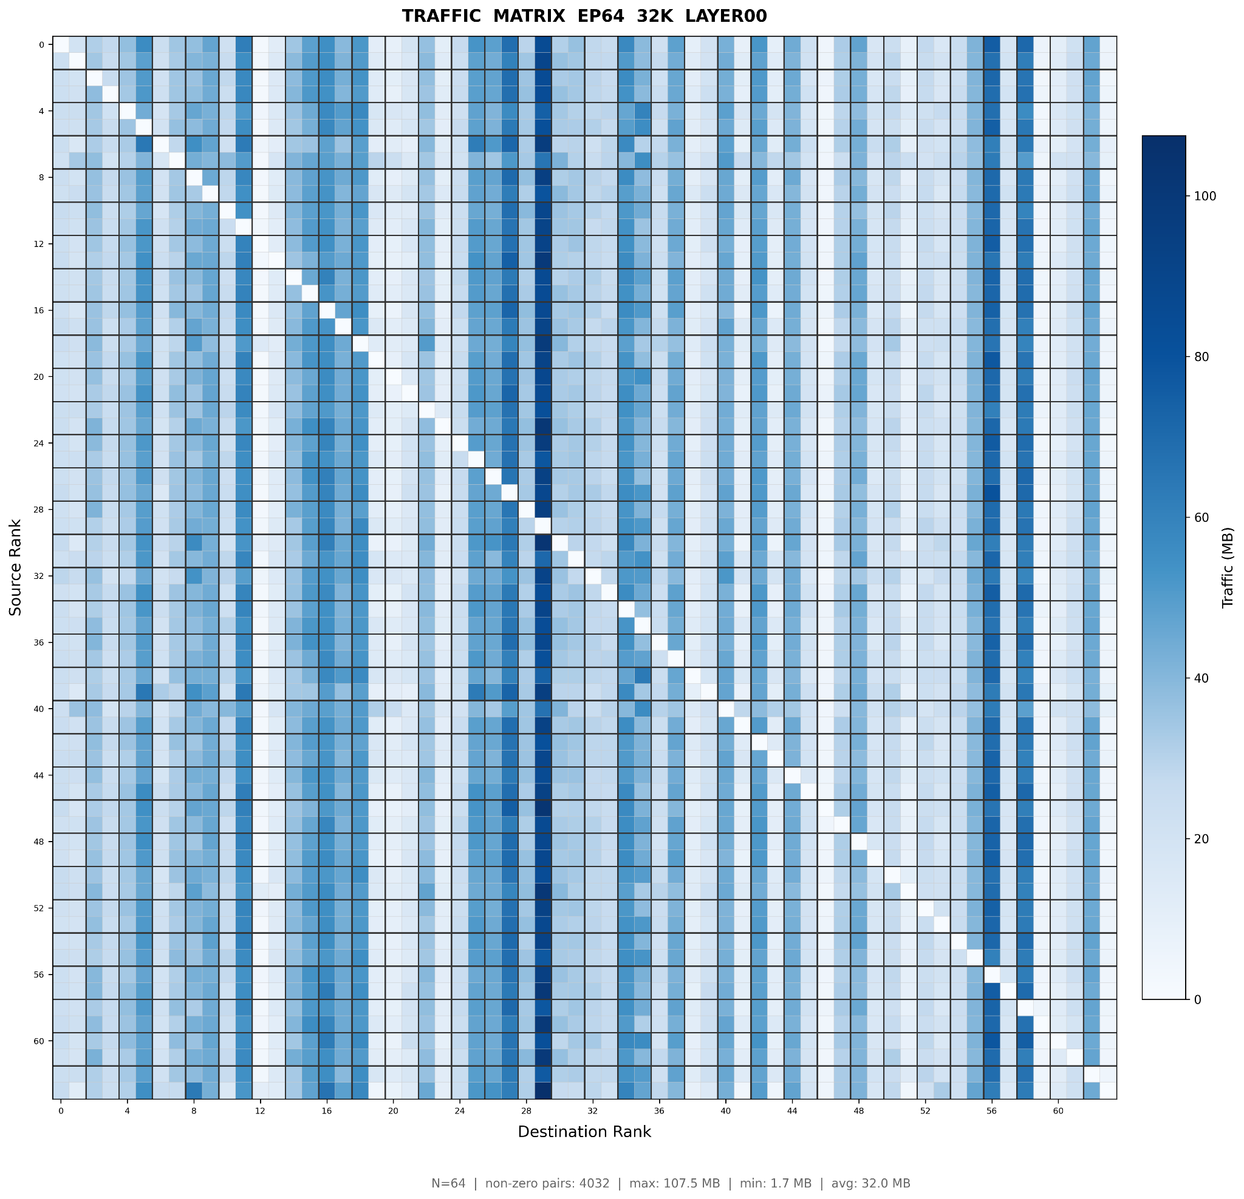
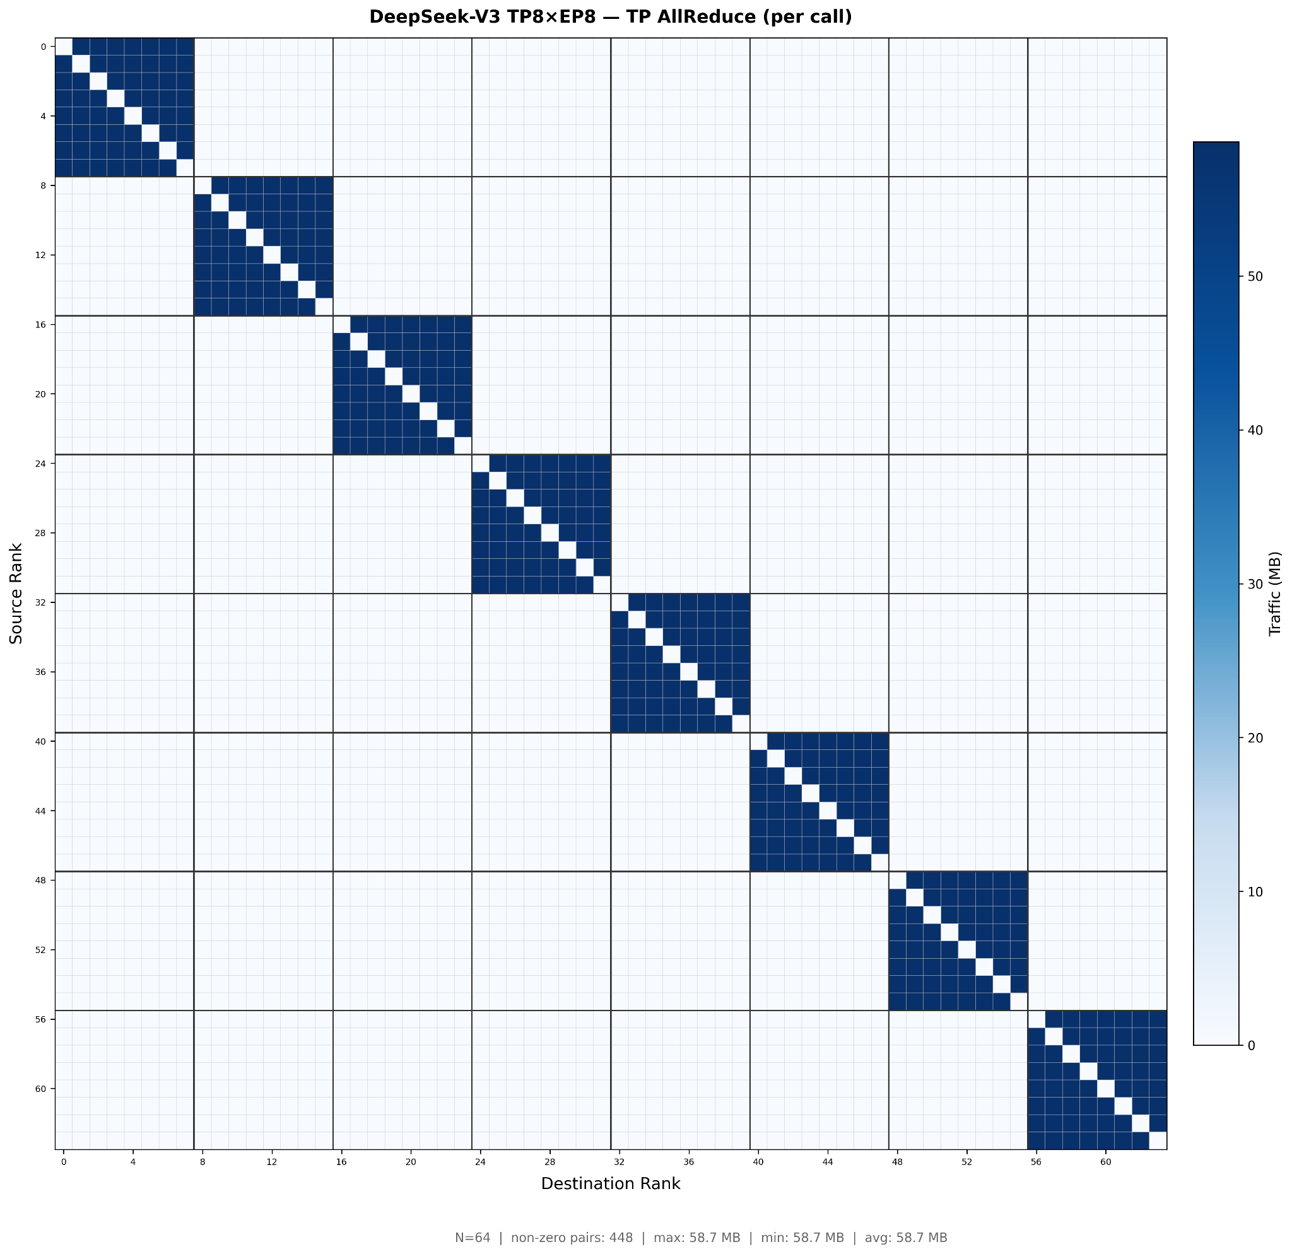
Routing Problem
Collective communication between ranks (participating xPUs) can be expressed as a demand matrix D.
D of size {N, N}, where N is the number of ranks in the system
D[i, j] denotes the number of bytes to be communicated between xPUs GPU_i to GPU_j
For example: demand matrix from Qwen3-235B A22B LLM training using EP64. Layer 0, 32K sequence, MoE all to all communication.
Non-deterministic
Non-uniform, see popular experts (darker columns)
For example: demand matrix from Deepseek V3 TP8 EP8 training, showing the TP all reduce communication.
Deterministic and can be worked out beforehand
Clear TP domain from the visualization

Slide 14
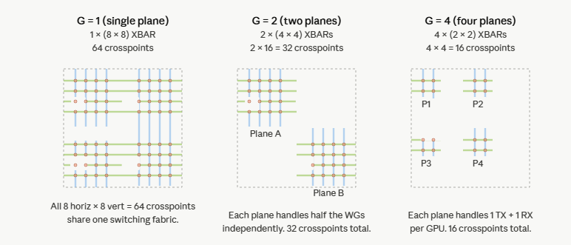
Routing with Parallel Planes
Idea: allow G (smaller) switching planes that can reconfigure independently.
For example, consider an 2x2 mesh of 4 GPUs, each GPU with 4 TX RX WGs.
G=1: single plane, 1x 8x8 xbar per tile with 64 cross points
G=2: 2 planes, 2x 4x4 xbars per tile with 32 cross points each
G=4: 4 planes, 4x 2x2 xbars per tile with 4 cross points each
More parallel planes reduces the crossbar complexity by G (number of cross points) and hides reconfiguration latency

Slide 15
Preliminary Evaluations
System architecture
GPU baseline 1: 64 H100 GPUs as 8 nodes with 8-rail 400 Gbps IB network
GPU baseline 2: hypothetical “NVL64” system with non-blocking NVLink Gen 4
GlassML: 64 H100 GPUs on a single panel
  Wavelength-Division Multiplexing (WDM) –
  32-channel WDM @ 32Gbps per channel and 8 switching planes
  32-channel WDM @ 56Gbps per channel and 8 switching planes
  32-channel WDM @ 112Gbps per channel and 8 switching planes
Workload evaluations
Most skewed layer profiled from Qwen3-235B MoE training stage
Qwen3-30B-A3B training iteration time – PP2 TP4 EP8 @ 8k seqlen

Slide 16
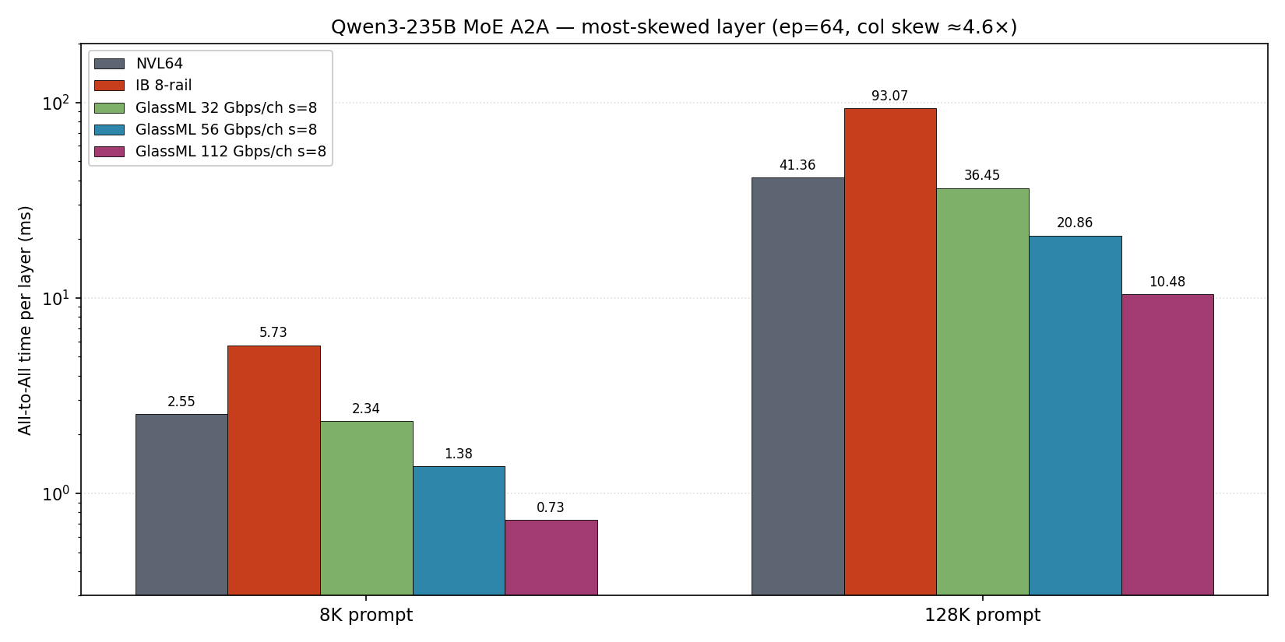
Communication Performance

Slide 17
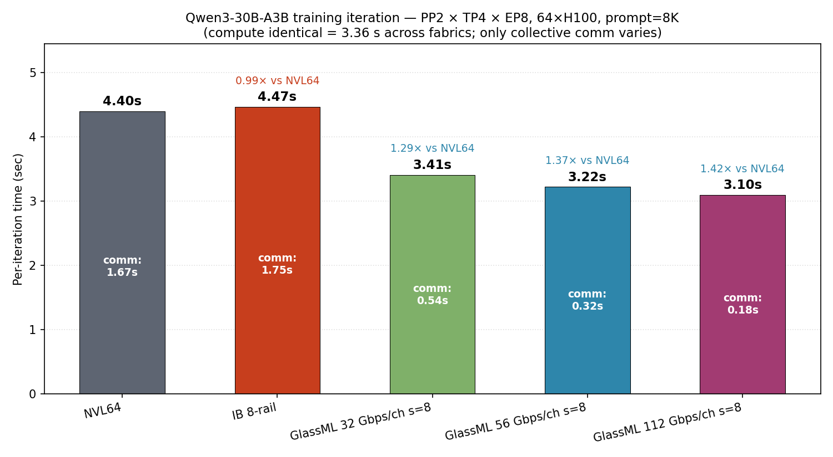
End to end training performance

Slide 19


Slide 20
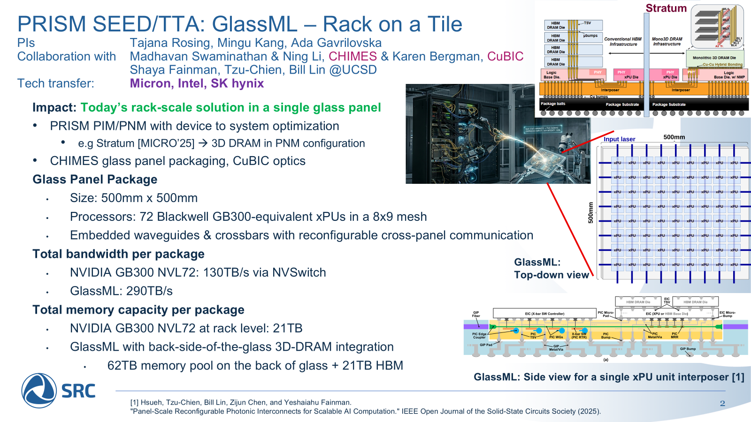

Slide 21
System assumptions
We consider system orchestrations that duplicates the interconnect performance of B200 NVL72 system
64 GPUs arranged as a 8x8 2D mesh (“NVL64”)
Per-WG capacity: ~1 Tb/s, so each GPU exposes 7 TX WGs + 7 RX WGs (14 WGs total) to match Blackwell NVLink bandwidth
Each GPU interface: 1.8 TB/s = 0.9 TB/s TX + 0.9 TB/s RX
Bisection bandwidth requirement: 72 × 1.8 TB/s = 130 TB/s

Slide 22
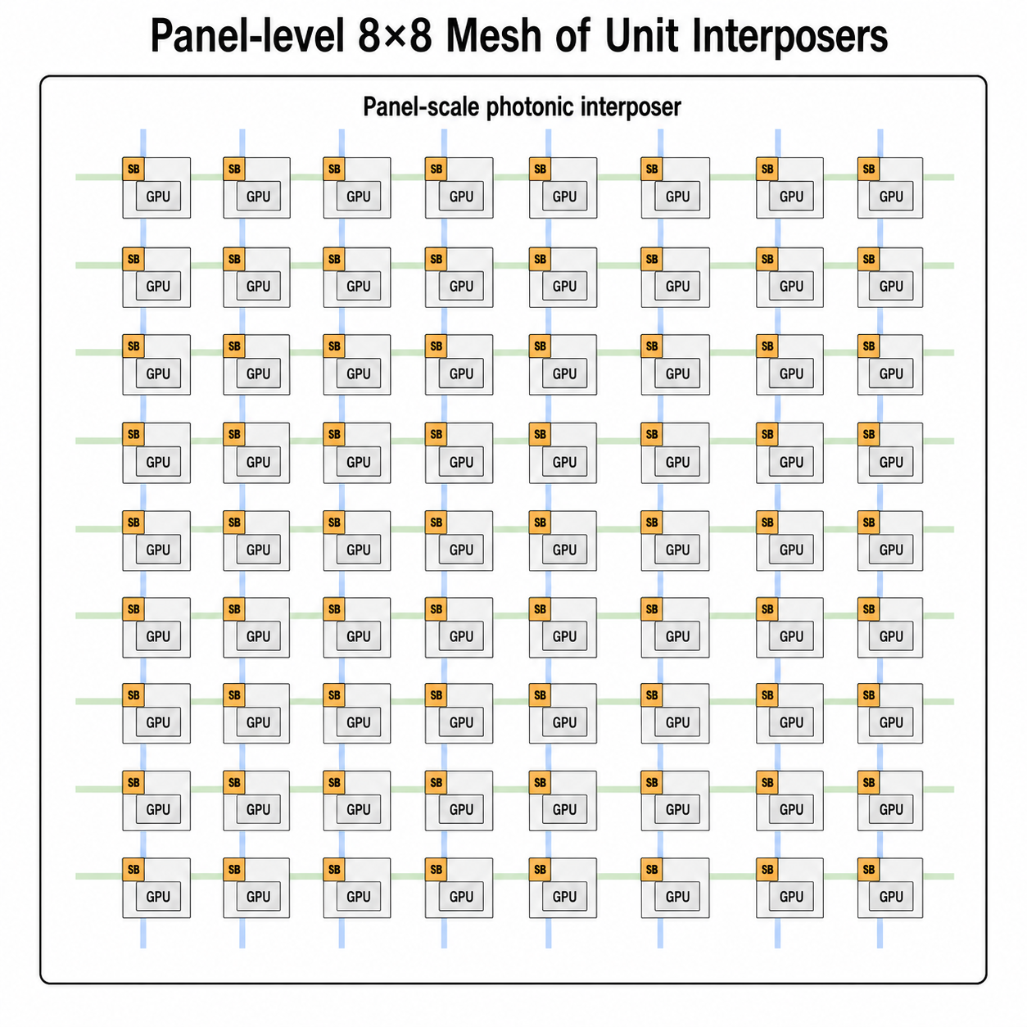
Glass Panel Routing Infrastructure
Example 8x8 Panel shown

Slide 23
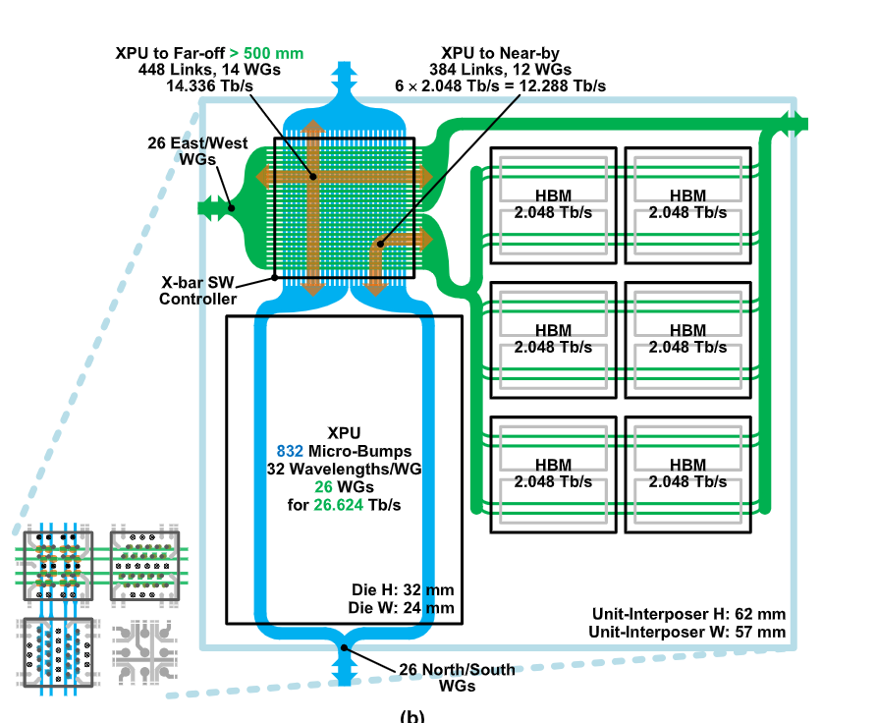
Unit Interposer
Example: A100 GPU as EIC
EIC and xbar switching are connected via microbumps to allow data communication between EICs in different unit interposers.
Local communications, e.g. xPU to HBM can also utilize a portion of WG instead of silicon interposer

Slide 24
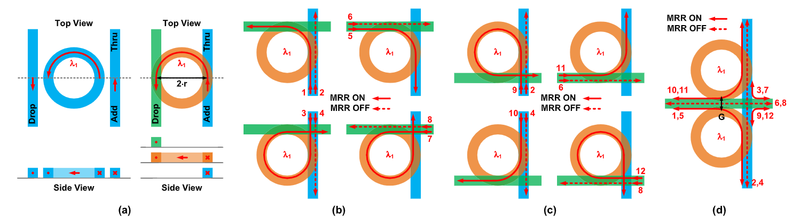
Switching fabric
At each unit interposer, horizontal optical links and verticals links cross each other.
Vertically-Coupled Add-Drop Racetrack Resonator (VC-AD-RTR) are used for switching
Racetrack are placed at each crossing of vertical and horizontal links
Racetrack can be reconfigured to individually control each crossing node routing (go straight or turn)
Per-waveguide routing is achieved between any direction of the optical crossbar (d)

Slide 25
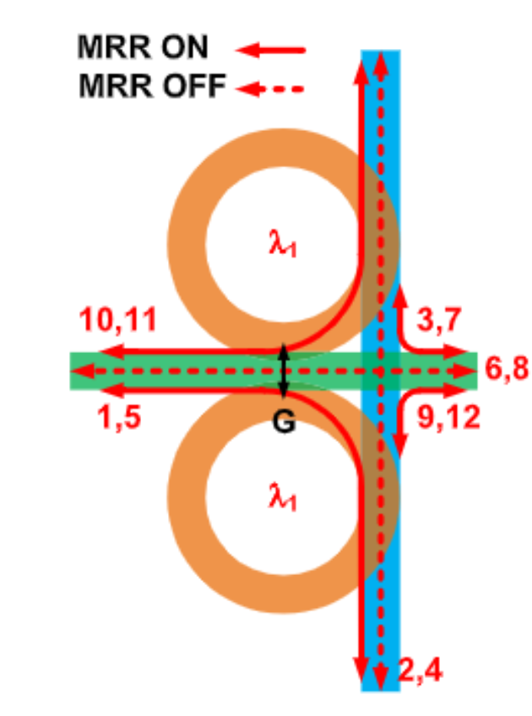
Glass Panel Routing Infrastructure
A single crosspoint is made up uses two racetrack resonators to enable all turning and through directions
Example 8x8 xbar shown.

Slide 26
Routing Problem
Collective communications in LLM training/inference
LLMs are too large to fit into a single GPUs, hence various parallelisms are used to split the model across multiple GPUs for the whole system to contain the model
TP / Tensor Parallel (hidden_dim): splits the MLP model weights across multiple GPUs
PP / Pipeline Parallel (num_layers): splits the model according to layers
EP / Expert Parallel: distributes expert weights across multiple GPUs
CP / Context Parallel (seq_len): splits the sequence dimension across multiple GPUs
We focus on TP and EP as they are adopted the most in training / inference systems, especially for MoE models

Slide 27
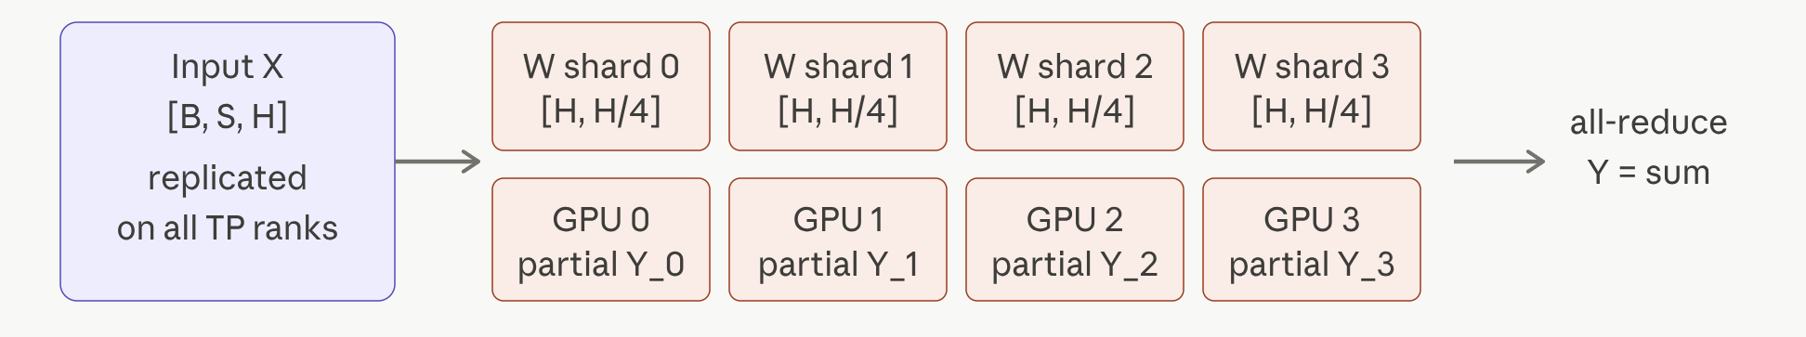
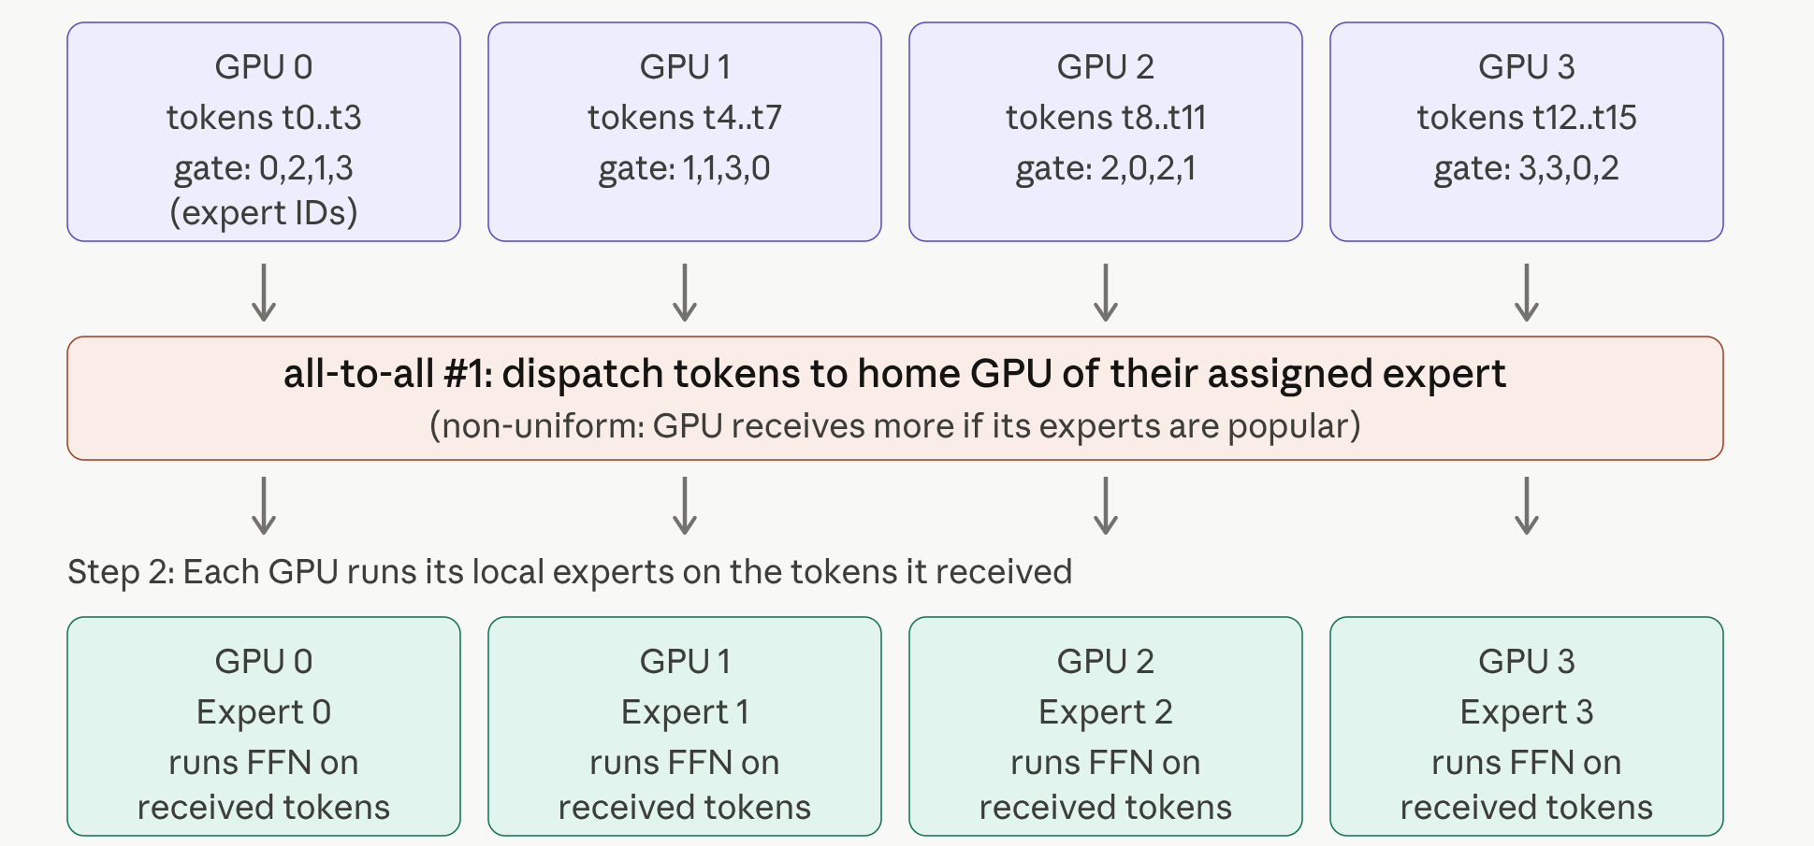
Routing Problem
TP / Tensor Parallelism
  Introduces two all-reduces before and after the MLP block
EP / Expert Parallelism
  Introduces two all-to-all before and after the expert MLP module

Slide 28
Routing Problem
Collective communication between ranks (participating xPUs) can be expressed as a demand matrix D.
D of size {N, N}, where N is the number of ranks in the system
D[i, j] denotes the number of bytes to be communicated between xPUs GPU_i to GPU_j
For example: demand matrix from Qwen3-235B A22B LLM training using EP64. Layer 0, 32K sequence, MoE all to all communication.
Non-deterministic
Non-uniform, see popular experts (darker columns)
For example: demand matrix from Deepseek V3 TP8 EP8 training, showing the TP all reduce communication.
Deterministic and can be worked out beforehand
Clear TP domain from the visualization

Slide 29
Routing Problem Definition
Given
  Demand matrix D
  Reconfiguration latency δ
Find
  A set of permutations {P_1 … P_k} and durations {d_1 … d_k} such that ∑ₖ dₖ · Pₖ ≥ D, thus completing the communication demand
  Pₖ is an N×N permutation matrix of 1 and 0s that denotes the connections between GPU pairs
  Goal is to minimize the makespan, M = ∑ₖ dₖ + δ · K
  makespan is the wall-clock time from the start of the communication until all demand has been delivered
Example of a permutation and corresponding circuit setup

Slide 30
Approach B: Parallel planes
Idea: allow G (smaller) switching fabrics that can reconfigure independently.
For example, consider an 2x2 mesh of 4 GPUs, each GPU with 4 TX RX WGs.
G=1: single plane, 1x 8x8 xbar per tile with 64 cross points
G=2: 2 planes, 2x 4x4 xbars per tile with 32 cross points each
G=4: 4 planes, 4x 2x2 xbars per tile with 4 cross points each
More parallel planes reduces the crossbar complexity by G (number of cross points)

Slide 31
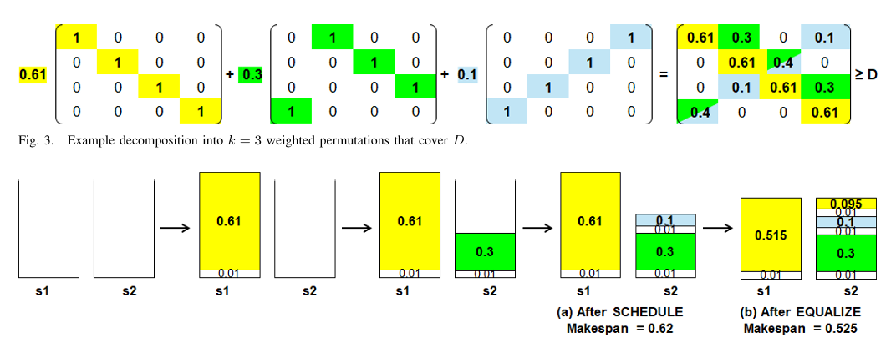
Approach B: Parallel Planes
Solving for parallel planes
DECOMPOSE: Break the demand matrix D into the smallest possible number of weighted permutations.
SCHEDULE: Assign the k permutations to the s parallel planes via greedy load balancing.
EQUALIZE: Refine the assignment by splitting permutations across planes when the imbalance exceeds δ
Example of 4x4 demand matrix with 2 planes
https://arxiv.org/pdf/2603.07373 https://webee.technion.ac.il/~isaac/p/nl26_scheduling.pdf

Slide 32
ML Workloads

Slide 35
Backup and old slides

Slide 36
GlassML: Panel-Scale Glass Interposer with Integrated
Reconfigurable Optics for Extreme-Scale ML
PRISM TTA
UCSD: Yue Pan, Junda Chen, Mingjia Huo, Zihan Xia, Jaewon Lee
Georgia Tech: Vima Gupta, Vishal Rao

Slide 37
ML Workloads Are Outgrowing Infrastructure
Capacity Wall
Limited HBM capacity forces costly solutions such as gradient checkpointing → 33% runtime overhead
Trillion-param MoE models (DeepSeek-V3: 0.7TB, Kimi-K2.5: ~2TB) exceed single-node VRAM capacity
Solutions such as CPU offloading interrupts training/inference flow and incurs severe penalty
Bandwidth Wall
High-bandwidth domain is limited, NVlink scaling subject to switch capability
Expensive LLM communication patterns: TP, SP, and MoE all-to-all
Copper PCB & rack cabling incur latency + energy penalties
SoTA GPU systems are fixed in network topology and have no configuration options
Scaling Wall
Silicon interposer bound by 300mm wafer reticle limit
Wafer-scale processors are subject to yield and size constraints

Slide 38
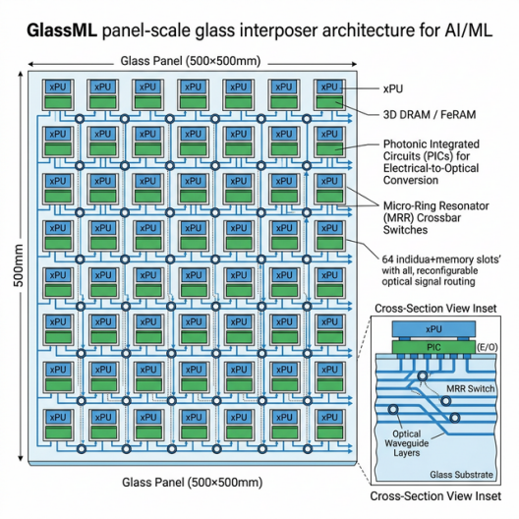
GlassML Vision

Slide 39
GlassML Architecture Overview
Key Numbers
500×500 mm glass panel (OJSSCS'25, ECTC'22)
Unit interposers for xPUs and memory, multi-TB capacity, in a mesh layout
PB/s-scale aggregate bandwidth via embedded optical waveguides at ~10 µm pitch
Dynamic network topology adaptation for application-specific communication patterns
Glass Panel Advantages
No 300mm reticle limit on silicon wafer, glass panels up to 510–610mm square
Decouples xPU process from substrate process, no yield issues in waferscale-like chips
Optical Interconnect Advantages
Considering a no-Serdes design: dramatically lower energy per bit
Distance-insensitive latency: 10–50ns across entire panel
Eliminates topology-induced NUMA (unlike wafer-scale chips)
Reconfigurable routing and adaptability according to workloads

Slide 40
Glass Interposer Components
Unit interposer (space reserved for the yellow block)
  Carved slots on the glass panel to contain PIC, EIC, and switching fabric
EIC (Electronic Integrated Chip)
  xPUs, memories, accelerators, CPUs
  There is no change to how EIC needs to be fabricated
PIC (Photonic Integrated Chip)
  Electric to optical conversions (E/O)
  Each E/O converters connects on exactly one signal pin on the xPU
  The TX driver sends an electrical signal through a micro-bump onto the PIC.
  The electric signal reaches the central electrode of an SRN MRR, which modulates the electric voltage into shift in resonant wavelength
  The RX driver on the receiving side operates in reverse to decode the optical frequency into electrical signals for xPUs
Waveguides (WG)
  Carries light signal, akin to a light fiber and are embedded into or deposited on top of glass
  Within each WG, WDM (Wavelength-Division Multiplexing) can be applied
  Reasonable link speed: 32Gb/s per wavelength, 32-degree WDM, 1Tbps per WG.
Notes:
where it modulates the refractive index of the ring via the χ(3) DC-Kerr effect — shifting the resonant wavelength slightly, which intensity-modulates the CW optical carrier at that wavelength passing through the adjacent waveguide.

Slide 41
Glass Interposer Overview
Input Laser
Input Laser
Optical Switching Crossbar
Unit
Interposer
Unit
Interposer
Horizontal WGs
Vertical WGs

Slide 42
Unit Interposer
Example: A100 GPU as EIC
EIC and xbar switching are connected via microbumps to allow data communication between EICs in different unit interposers.
Local communications, e.g. xPU to HBM can also utilize a portion of WG instead of silicon interposer

Slide 43
Switching fabric
At each unit interposer, horizontal optical links and verticals links cross each other.
Vertically-Coupled Add-Drop Racetrack Resonator (VC-AD-RTR) are used for switching
Racetrack are placed at each crossing of vertical and horizontal links
Racetrack can be reconfigured to individually control each crossing node routing (go straight or turn)
Per-waveguide routing is achieved between any direction of the optical crossbar

Slide 44
GlassML Routing
Routing on glass panel forms a circuit switching problem
Resource contention
WG, Rx Tx E/O converters
Brown and red communication paths must not take place simultaneously using the same WG
The two red communication paths can take place simultaneously on the same WG
Bandwidth reconfigurability
Each node-pair can be allocated different bandwidth depending on needs

Slide 45
GlassML Routing
Problem formulation
There are 4 key parameters in discussion.
N: grid dimension (N×N = N² xPUs)
n_wg: number of waveguides per direction per row or column (in the OJSSCS paper: 14 north/south, 12 east/west)
bw: bandwidth per waveguide, including any WDM (wavelength-division-multiplexing)
δ: reconfiguration latency of the crossbar switches (not specified in the OJSSCS paper; a parameter we sweep)
Based on the above formulation, we solve a problem of the following
A collective communication operator is represented as a demand matrix of N² by N²
Each entry: the amount of data to be communicated between the pair of xPUs
Goal: Find the network configuration (or sequence of network reconfigurations) that completes the collective communication and minimizes the latency of this communication operator.

Slide 46
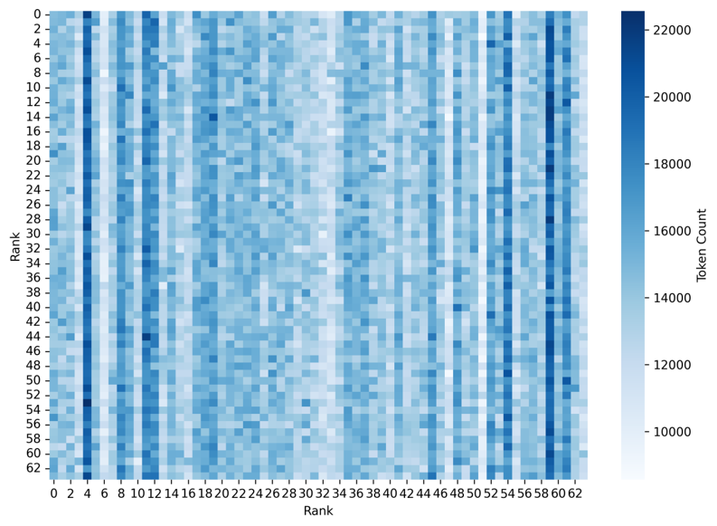
Updates on routing
MoE traffic matrix heatmap from 64 sender GPUs (rows) to 64 receiver GPUs (columns).
MoE traffic matrix obtained by running the Qwen2 MoE model (57B) on Megatron-LM across 64 NVIDIA H100 GPUs, organized as 8 HGX nodes (with 80 GB per GPU).

Slide 47
Updates on routing
Chronos (NAIC’25) paper agrees non-MoE traffic can be precomputed from training code
For MoE traffic, a number of decomposition algorithms can be used
Chronos (NAIC’25) proposes repeated “maximal size matchings” (MSM) in hardware for speed
Key observation:
For all-to-all traffic, we can precompute a random orthogonal (i.e., each element is just covered by one permutation) set of 71 permutations that are “maximal size matchings”
For each permutation, take the “max” value as the “duration.”
Simulations show this works well even when the demand matrix entries vary by 2-2.5X or even by 10X, with max channel load = 40-75 WGs (way under the 126 WGs in the design)
Derived/precomputed permutations implemented as XY circuits
All 7 TX/7 RX WGs used for a permutation, estimated duration for 100-220MB around 140-300ms.
At least 71 permutations = at least 71 reconfiguration delays d.
Not an issue for d = 10’s of ns, but an issue if d = 10’s to 100’s of ms.

Slide 48
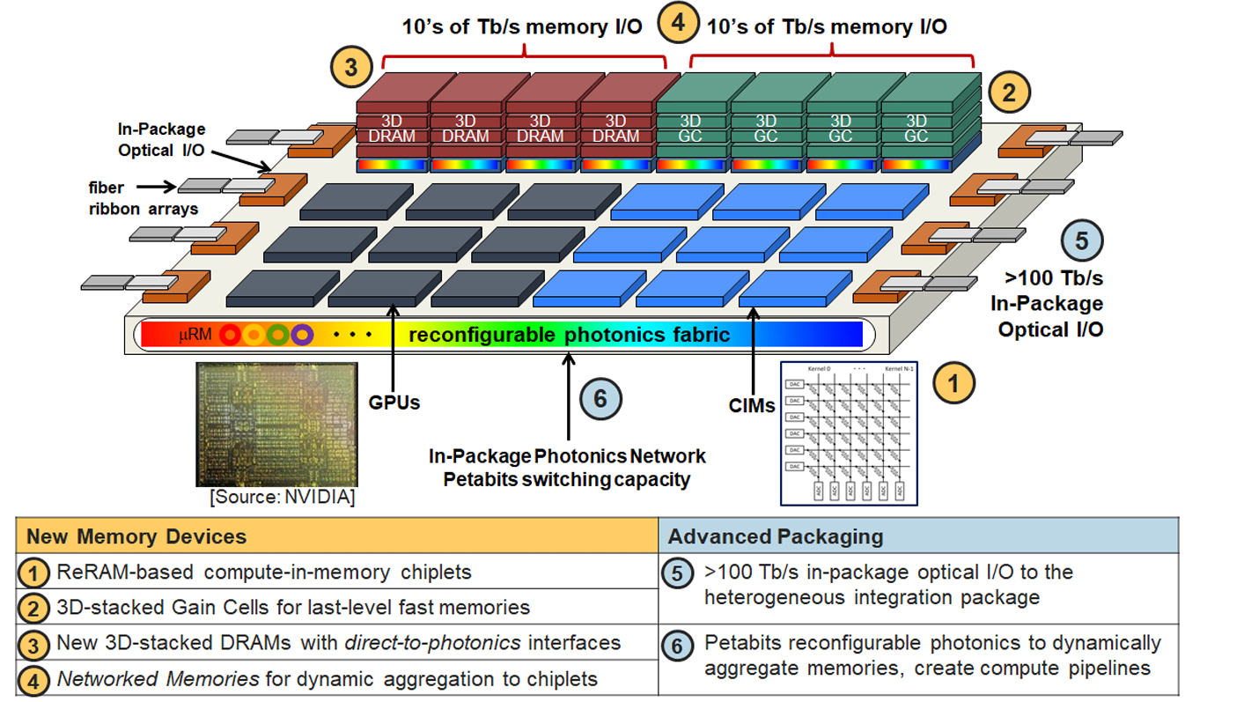
Heterogeneous Glass Panel

Slide 49
System 1: NVL72 on a panel
First step, most direct system configuration on a glass panel
We need to evaluate this design to justify the feasibility of glass panel as a from 0 to 1 work
Workloads: LLM (MoE) training and inference
Communication:
  TP all reduce
  MoE all to all
H100
H100
H100
H100
H100
H100
H100
H100
H100
H100
H100
H100
H100
H100
H100
H100
Assume 8x9

Slide 50
System 2: Prefill-decode disaggregation (inference)
LLM inference is divided into two phases: prefill and decode
Prefill: batched processing of input prompts – compute bound due to mostly batched operations
Decode: autoregressive generation of output tokens – memory bound due to smaller GEMM dimensions
Special Communications:
  KV cache transfer between Prefill and Decode instances
H100
P
H100
P
H100
P
H100
P
H100
D
H100
D
H100
P
H100
P
H100
D
H100
D
H100
D
H100
D
H100
D
H100
D
H100
D
H100
D

Slide 51
System 3: heterogeneous system with PIM/PNM
Why PIM
Processing in/near memory enhances memory bandwidth with new memory technologies
  Example: Logic-on-base-die for 3D DRAM or HBM
  Improves decoding throughput and other memory bound operations
P/D disaggregation
  GPU as prefill instances
  PIM/PNM as decode instances
Special communications
  KV cache transfer between Prefill and Decode instances
H100
H100
H100
H100
H100
H100
H100
H100
PIM
PIM
PIM
PIM
PIM
PIM
PIM
PIM

Slide 52
System 4: Hardware memory pool
Assume GPUs without local memory and hardware memory pool
Special communications
  No weight duplication required for P/D disaggregation
  Overall traffic volume due to weight and KV streaming
Another option: dedicated hardware KV pool on panel
H100
H100
H100
H100
H100
MEM
MEM
H100
H100
MEM
MEM
H100
H100
H100
H100
H100

Slide 53
Further opportunities
Light splitter for near-free data multicasting
Optical PHY for HBM and other memories (optical HBM)

Slide 54
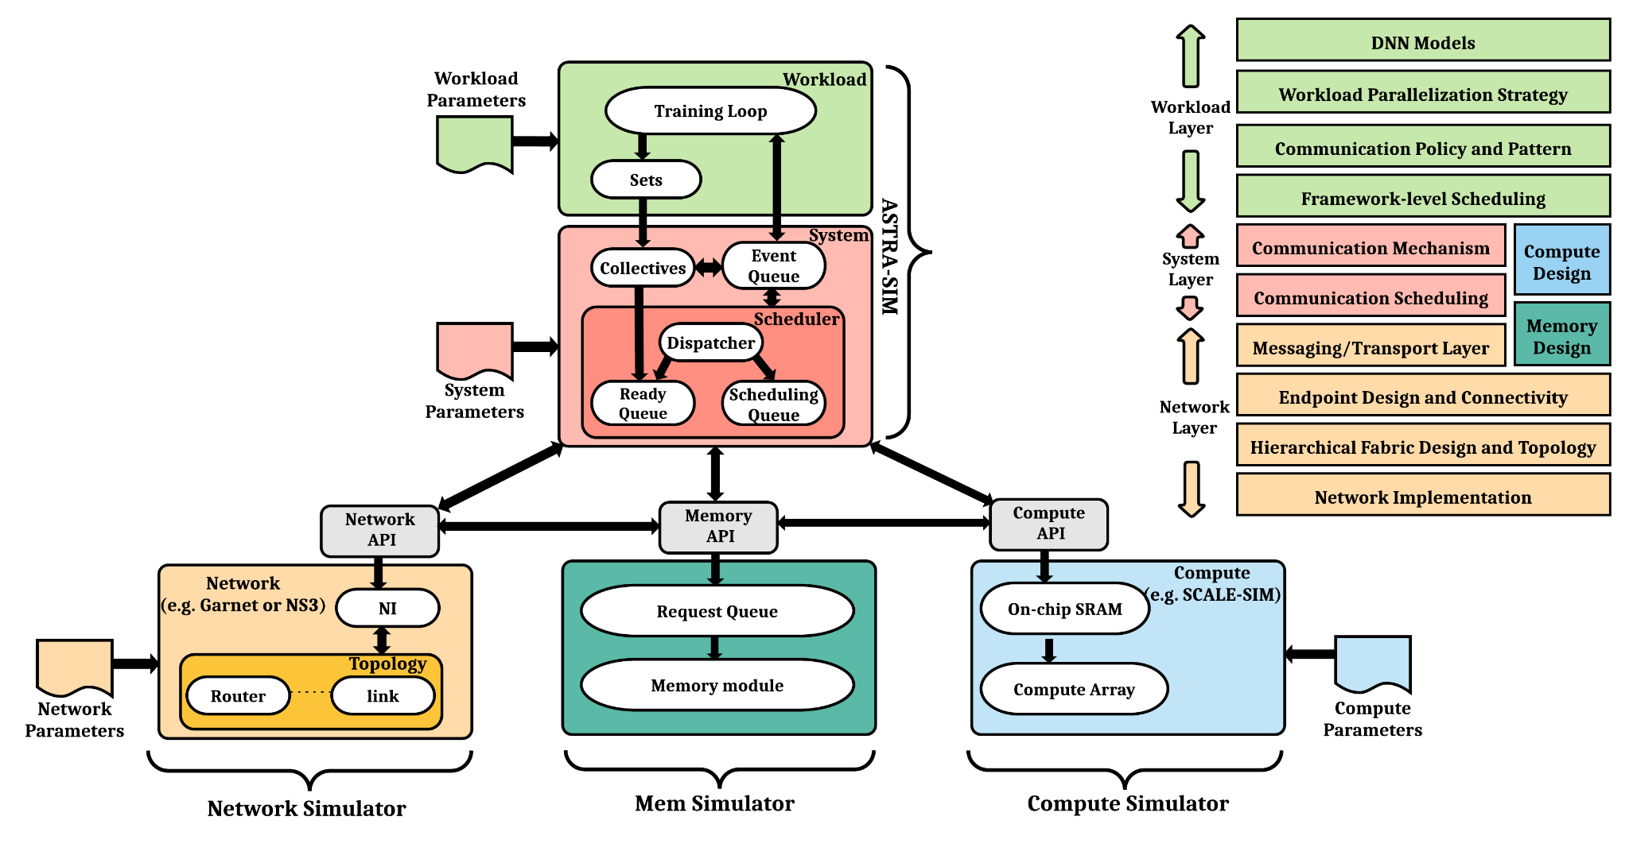
Simulation: Astra-sim
Programmatically generate based on model config
MoE all to all from profiling and synthetic
No change
Custom design for our panel-scale network
Operator-granularity profiling from actual GPUs
Not relevant

Slide 55
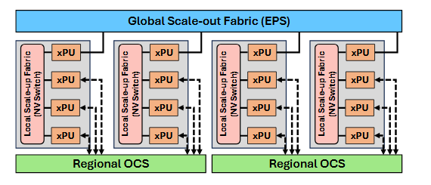
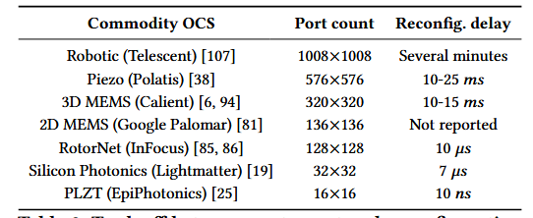
MixNet (SIGCOMM'25)
Workload: MoE training
System: 128 GPUs
Problem: larger OCS (w.r.t number of ports) has extra long reconfiguration delay. Smaller OCS reconfigs faster but does not have enough ports.
Solution:
  Use multiple instances of medium scale Regional OCS that reconfigures at millisecond-level
  Breaks down the global np-hard scheduling problem into localized greedy problems
  Overlaps reconfiguration with layer forward time (100ms-scale)

Slide 56
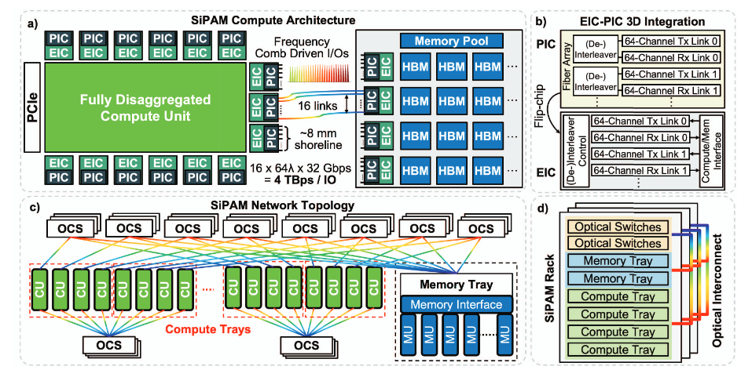
Silicon Photonic Accelerated Memory Pooling for Efficient Compute Resource Allocation (HotInterconnect’25)
SiP (CPO) I/O bandwidth density (4 Tbps/mm) >> HBM electrical interface (83 GBps/mm)
Fully remove electrical interfaces from the system and go all in on CPO
Full compute-memory disaggregation (system 4 idea)
Does not addressing routing problem and does not touch MoE models

Slide 57


Slide 58
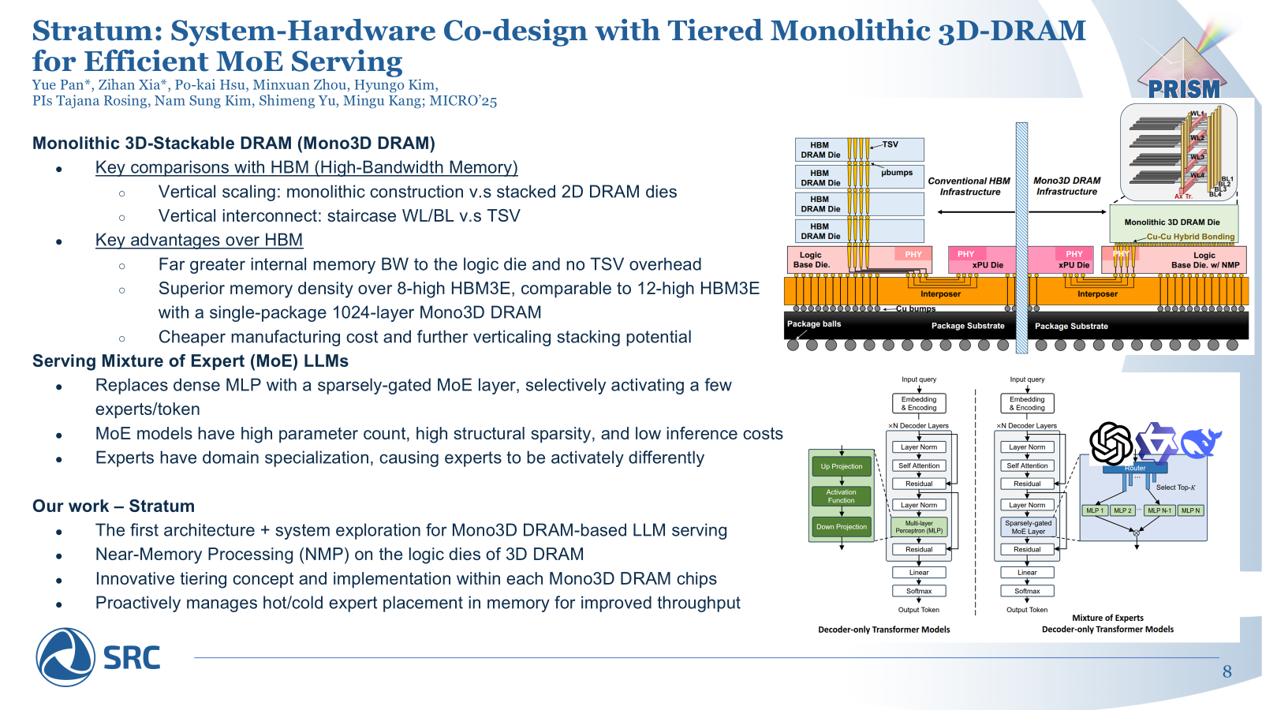

Slide 59
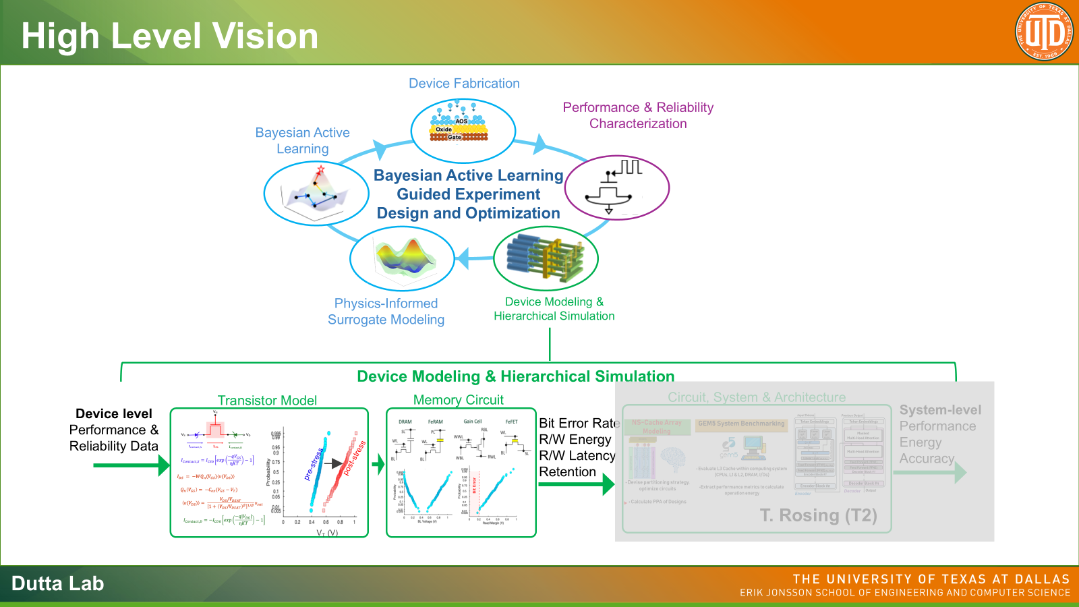
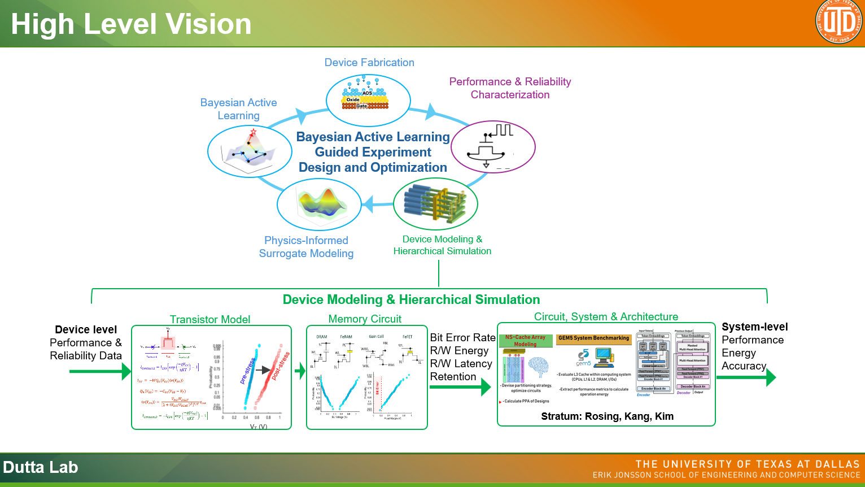

Slide 60
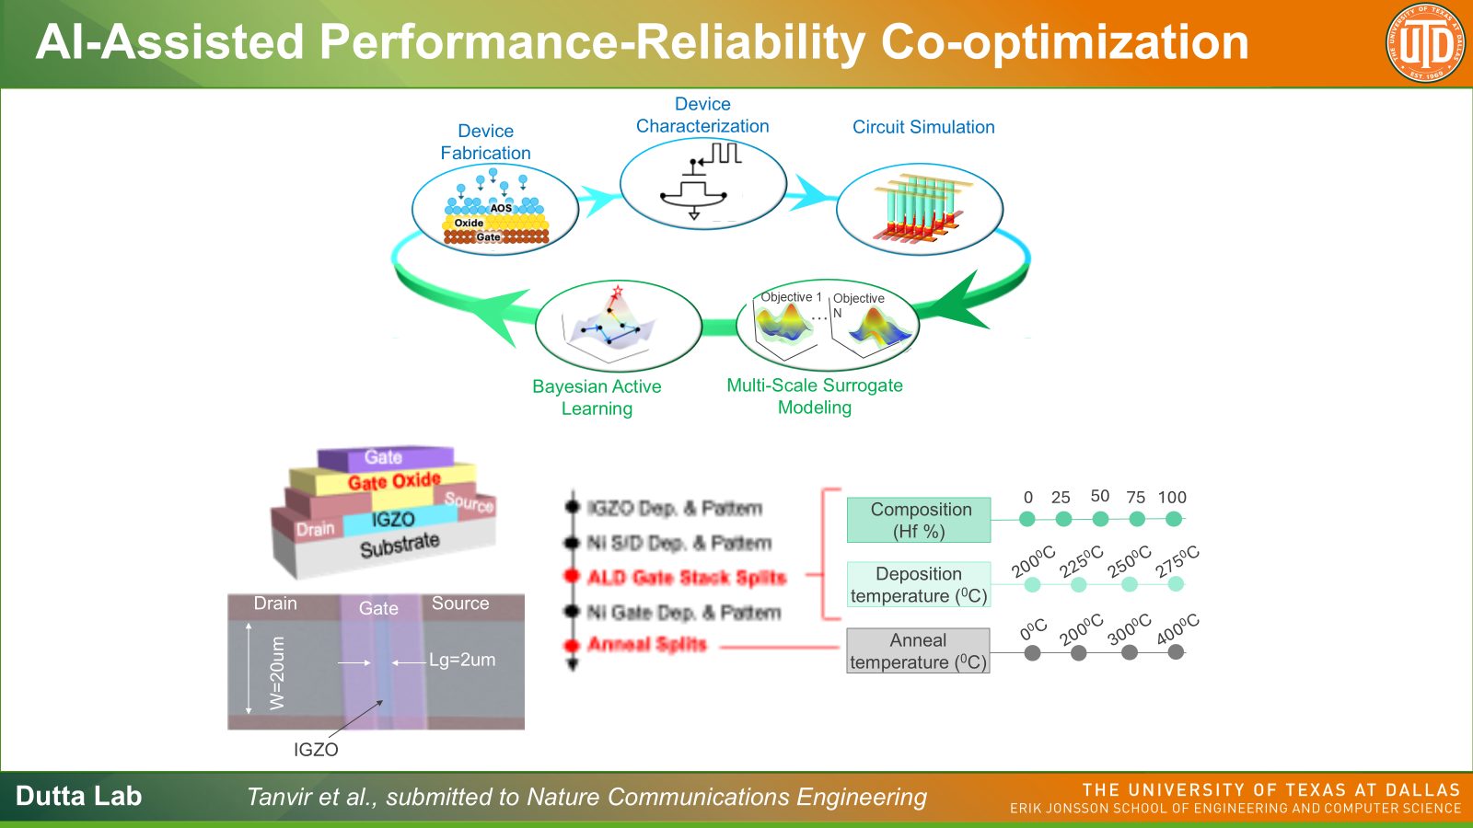

Slide 61
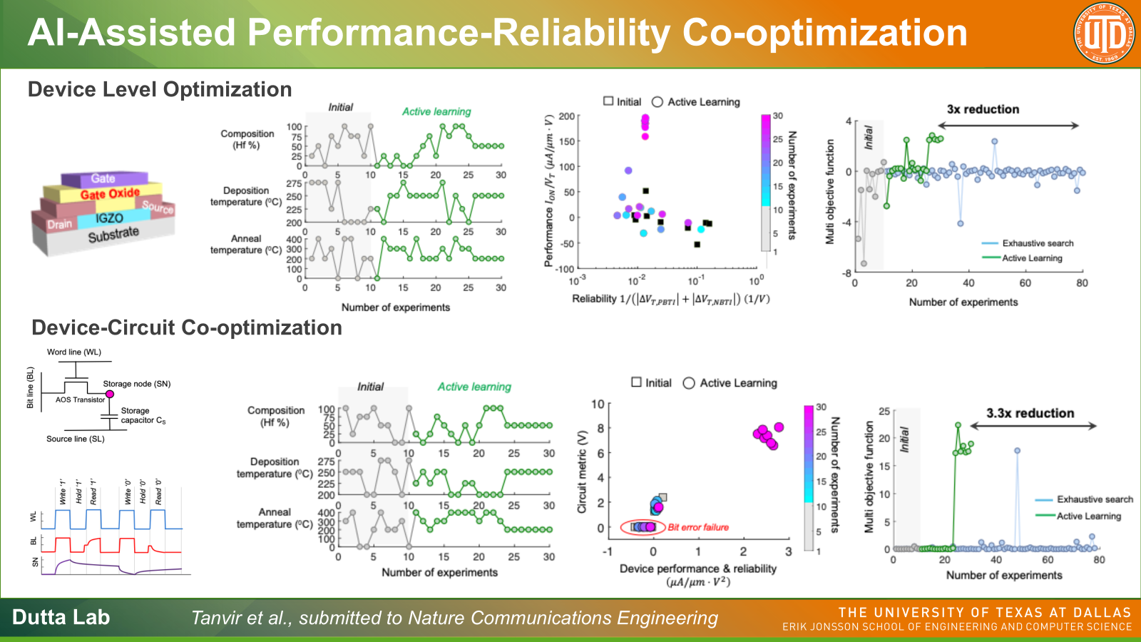

Slide 64
Past Slides

Slide 65
GlassML: Panel-Scale Glass Interposer with Integrated
Reconfigurable Optics for Extreme-Scale ML
PRISM TTA
UCSD: Yue Pan, Junda Chen, Mingjia Huo, Zihan Xia, Jaewon Lee
Georgia Tech: Vima Gupta, Vishal Rao

Slide 66
ML Workloads Are Outgrowing Infrastructure
Capacity Wall
Limited HBM capacity forces costly solutions such as gradient checkpointing → 33% runtime overhead
Trillion-param MoE models (DeepSeek-V3: 0.7TB, Kimi-K2.5: ~2TB) exceed single-node VRAM capacity
Solutions such as CPU offloading interrupts training/inference flow and incurs severe penalty
Bandwidth Wall
High-bandwidth domain is limited, NVlink scaling subject to switch capability
Expensive LLM communication patterns: TP, SP, and MoE all-to-all
Copper PCB & rack cabling incur latency + energy penalties
SoTA GPU systems are fixed in network topology and have no configuration options
Scaling Wall
Silicon interposer bound by 300mm wafer reticle limit
Wafer-scale processors are subject to yield and size constraints

Slide 67
LLM Training: Network-Bound at Scale
Training Bottleneck Shifts with Scale
1–8 GPUs: compute-bound
64+ GPUs: compute to network transition
16K+ GPUs: dominated by network and compute
Communication Overhead Dominates
All-reduce for gradient sync grows with model + cluster size
MoE Expert Parallel all-to-all: 33–55% of training iteration on 400Gbps networks [SIGCOMM'25]
Disk checkpointing is blocking — memory can't hold a second copy for async [SC'21]
Weight duplication: NVL72 with 13TB holds only ~3 copies of a 2T model [GB300 NVL72]
Emerging Workload Challenges
Video diffusion (Sora, Wan): dense spatiotemporal latents across hundreds of frames → MFU 30–40%
World models: real-time at 30+ FPS, zero room for communication overhead
EP efficiency degrades with token batching [Lynx, arXiv'24]

Slide 68
GlassML Vision

Slide 69
GlassML Architecture Overview
Key Numbers
500×500 mm glass panel (OJSSCS'25, ECTC'22)
Unit interposers for xPUs and memory, multi-TB capacity, in a mesh layout
PB/s-scale aggregate bandwidth via embedded optical waveguides at ~10 µm pitch
Dynamic network topology adaptation for application-specific communication patterns
Glass Panel Advantages
No 300mm reticle limit on silicon wafer, glass panels up to 510–610mm square
Decouples xPU process from substrate process, no yield issues in waferscale-like chips
Optical Interconnect Advantages
Considering a no-Serdes design: dramatically lower energy per bit
Distance-insensitive latency: 10–50ns across entire panel
Optical multicast: broadcast for near-free; MRR crossbar switches enable runtime reconfiguration (IEEE OJSSCS'25)
Eliminates topology-induced NUMA (unlike wafer-scale chips)
Reconfigurable routing and adaptability according to workloads

Slide 70
Glass Interposer Overview
Input Laser comb source
Input Laser comb source
Optical Switching Crossbar
Unit
Interposer
Unit
Interposer
Horizontal WGs
Vertical WGs

Slide 71
Unit Interposer
Example: A100 GPU as EIC
EIC and xbar switching are connected via microbumps to allow data communication between EICs in different unit interposers.
Local communications, e.g. xPU to HBM can also utilize a portion of WG instead of silicon interposer

Slide 72
Unit Interposer
Example: A100 GPU as EIC
EIC and xbar switching are connected via microbumps to allow data communication between EICs in different unit interposers.
Local communications, e.g. xPU to HBM can also utilize a portion of WG instead of silicon interposer

Slide 73
Glass Interposer Components
Unit interposer (space reserved for the yellow block)
  Carved slots on the glass panel to contain PIC, EIC, and switching fabric
EIC (Electronic Integrated Chip)
  xPUs, memories, accelerators, CPUs
  Heterogeneous EICs integration is possible
PIC (Photonic Integrated Chip) (yellow block)
  Handles electric to optical signal conversion (E/O)
Waveguides (WG)
  Carries light signal, akin to a light fiber and are embedded into or deposited on top of glass

Slide 74
Heterogeneous Glass Panel

Slide 75
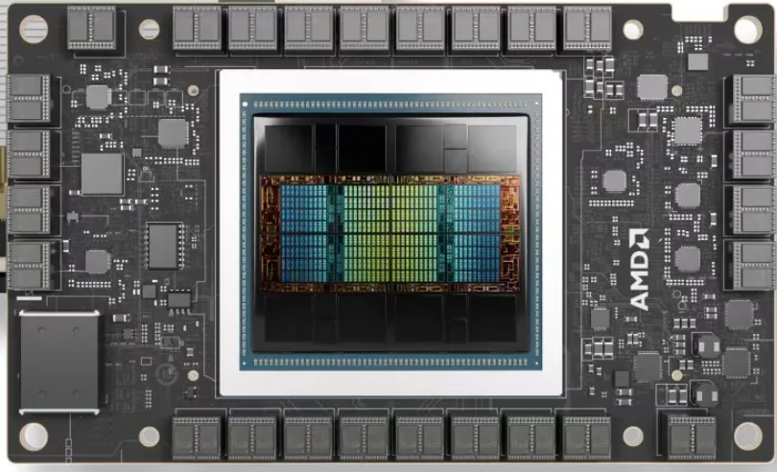
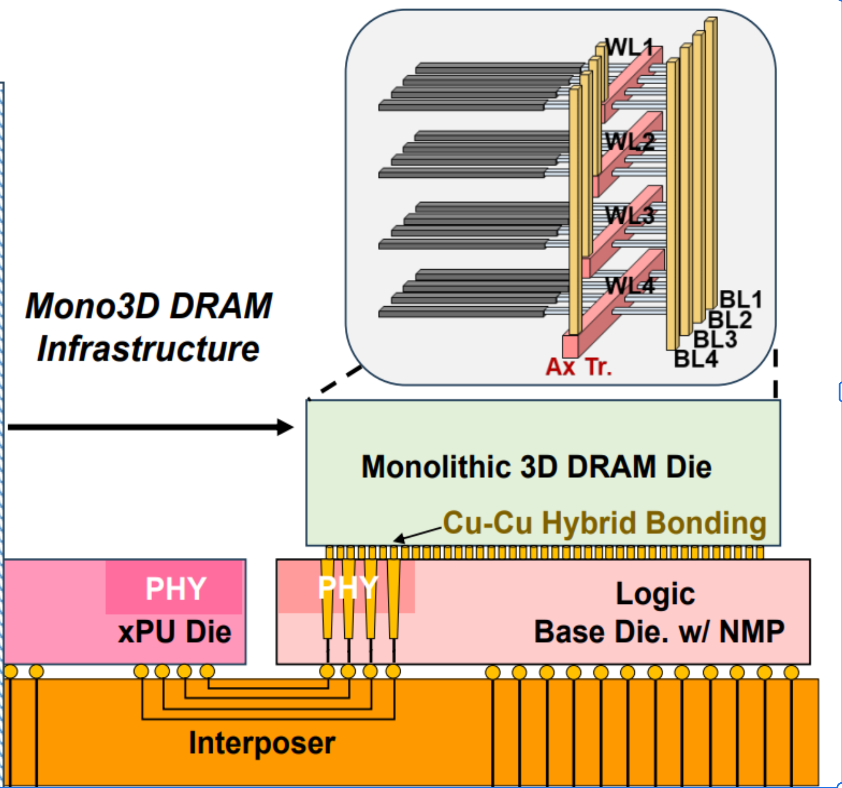
Heterogeneous EIC Options
Compute-variant
H100 / B200 or similar GPU compute die with or without local memory
Custom LLM accelerators
Capacity-variant
Hardware memory pool using variants of memory technology
Optical interfaces allow data communication to the entire panel
Processing-near-memory (PNM) variant
Monolithic 3D Stackable DRAM (MICRO’25)
  Hybrid-bonding interconnect between M3D DRAM and base die
  PNM logic on base die benefit from extreme internal bandwidth
  free from TSV constraints (~20 TB/s)

Slide 76
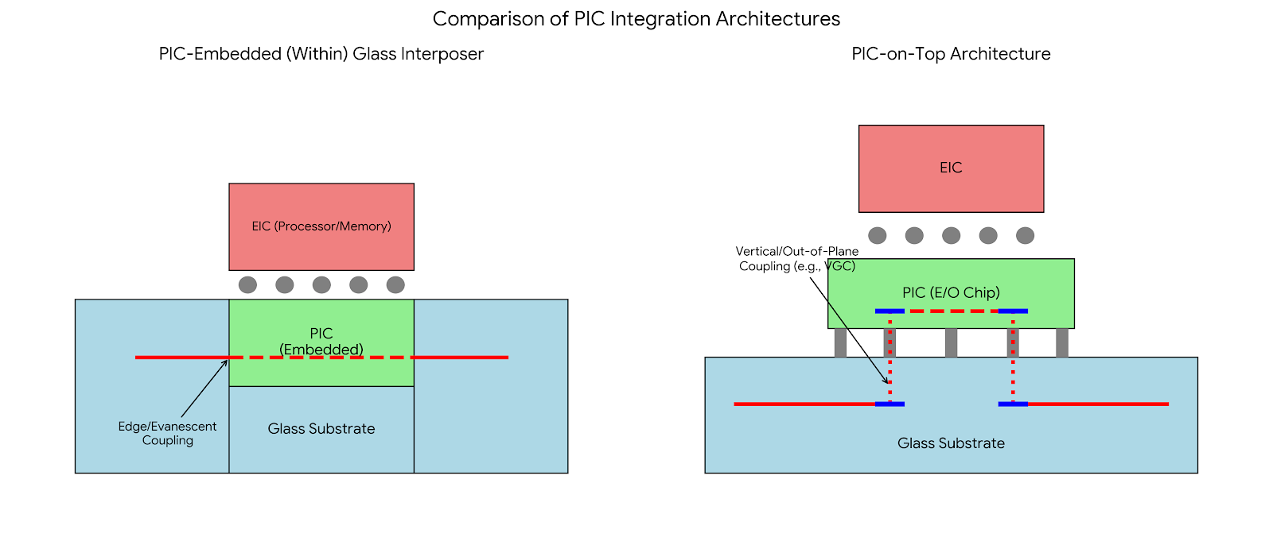
Glass Interposer Design Options
PIC embedded (left)
PIC is embedded into the glass
Light goes through PIC
Switching is done inside the PIC
Limited switching room and WG routing space within the glass
PIC-on-top (right)
PIC sits on top of the glass
Light goes in/out PIC at every node
Switching is inside the PIC
More area for switching fabric (entire PIC) and WG routing space
More loss to incur by mirroring light into the PIC above

Slide 77
Switching fabric
At each unit interposer, horizontal optical links and verticals links cross each other.
Vertically-Coupled Add-Drop Racetrack Resonator (VC-AD-RTR) are used for switching
Racetrack are placed at each crossing of vertical and horizontal links
Racetrack can be reconfigured to individually control each crossing node routing (go straight or turn)
Per-waveguide routing is achieved between any direction of the optical crossbar

Slide 78
GlassML Routing
Reconfiguration optical interconnect require optical circuit switching, different from packet switching commonly used in copper-based interconnect.
Resource contention
WG, Rx Tx E/O converters
Brown and red communication paths must not take place simultaneously using the same WG
The two red communication paths can take place simultaneously on the same WG
Bandwidth reconfigurability
Each node-pair can be allocated different bandwidth depending on needs

Slide 79
GlassML Routing
Problem formulation
There are 4 key parameters in discussion.
N: grid dimension (N×N = N² xPUs)
n_wg: number of waveguides per direction per row or column (in the OJSSCS paper: 14 north/south, 12 east/west)
bw: bandwidth per waveguide, including any WDM (wavelength-division-multiplexing)
δ: reconfiguration latency of the crossbar switches (not specified in the OJSSCS paper; a parameter we sweep)
Based on the above formulation, we solve a problem of the following
A collective communication operator is represented as a demand matrix of N² by N²
Each entry: the amount of data to be communicated between the pair of xPUs
Goal: Find the network configuration (or sequence of network reconfigurations) that completes the collective communication and minimizes the latency of this communication operator.

Slide 80
GlassML System example
As a first step, we replicate the NVL72 rack performance using just one glass panel with glass interconnect
72 GB300 GPUs in a single NVLink domain
P2P communication achieved through expensive rack-scale switch
Bidirectional bandwidth per GPU: 1.8 TB/s
Glass Panel Setups
64 GPUs laid out in an 8x8 mesh (8x9 is possible too to exactly match NVL72)
Each GPU is allocated 16 waveguides at 1Tbps each.
  Each GPU’s bidirectional bandwidth is 2TB/s
Each crossnode contains a 128x128 crossbar (switchbox) using racetrack switches
  Pitch of a racetrack: ~50um
  Power of a racetrack: ~0.015mW

Slide 81
System composition example
NVL72 (HBM3e)
Glass + HBM3e Pool
Glass (heterogeneous)
Slot Types
72 GPUs (homogeneous)
64 xPU+HBM slots
xPU slots + 3D DRAM slots
Per-slot Memory
192 GB
192 GB
960 GB (3D DRAM slots)
Total System Memory
~13 TB
~12 TB
Configurable, up to ~60 TB
Per-slot BW
8 TB/s
8 TB/s
20 TB/s (3D DRAM slots)
NMP Compute
None
None
500 TFLOPS/die (3D DRAM)
Heterogeneous integration is possible given glass interposer
Some slots dedicated to xPU (compute), some to 3D DRAM (memory)
Shared optical memory pool: model weights stored once, no duplication across slots

Slide 82
Potential Application: MoE Inference
Prefill-Decode Disaggregation
  Prefill (compute-bound) → dedicate high-FLOPS xPU slots
  Decode (memory-BW-bound) → 3D DRAM slots or similar high memory bandwidth processors
  Panel-scale memory pool design → No weight duplication required on GPU architectures
Expert Routing Optimization
  Predict expert loads via router confidence scores or topic-based statistical usage [Lynx, arXiv'24; Stratum, MICRO'25]
  Predict expert usage through inter-layer expert choice correlation
  Prediction-guided dynamic network configuration to adapt to communication patterns

Slide 83
Potential Application: Training and Video Generation
MoE Training on GlassML
Tailored optical networks for Expert Parallelism: workload-adaptive BW allocation [SIGCOMM'25]
Dynamic batch-aware expert selection: per batch, per layer [Lynx, arXiv'24]; router confidence for remapping: no prior profiling required
Significantly reduce all-to-all overhead, as much as 55% of training iteration time (SIGCOMM’25)
Video Generation & World Models
Sora, Wan: latent tensors >> LLM KV-caches, need multi-TB memory [Sora, OpenAI'24; Wan, arXiv'25]
60 TB Glass+3DDRAM eliminates checkpointing and improve MFU (SoTA 30–40%)
World models: 30+ FPS requires <33ms per step; 10–50ns on-panel latency meets real-time
20 TB/s per-slot BW for dense spatiotemporal data [Stratum, MICRO'25]
[SIGCOMM'25] Liao et al., MixNet | [arXiv'24] Gupta et al., Lynx | [MICRO'25] Pan et al., Stratum

